Slide 1
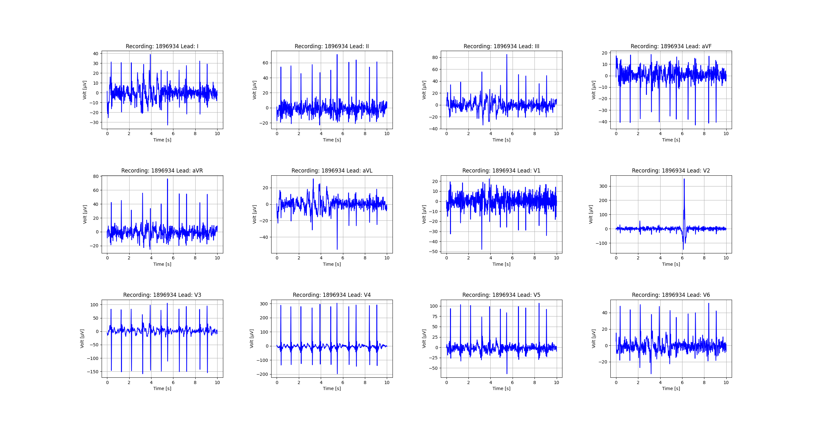
Figure_1

Slide 2
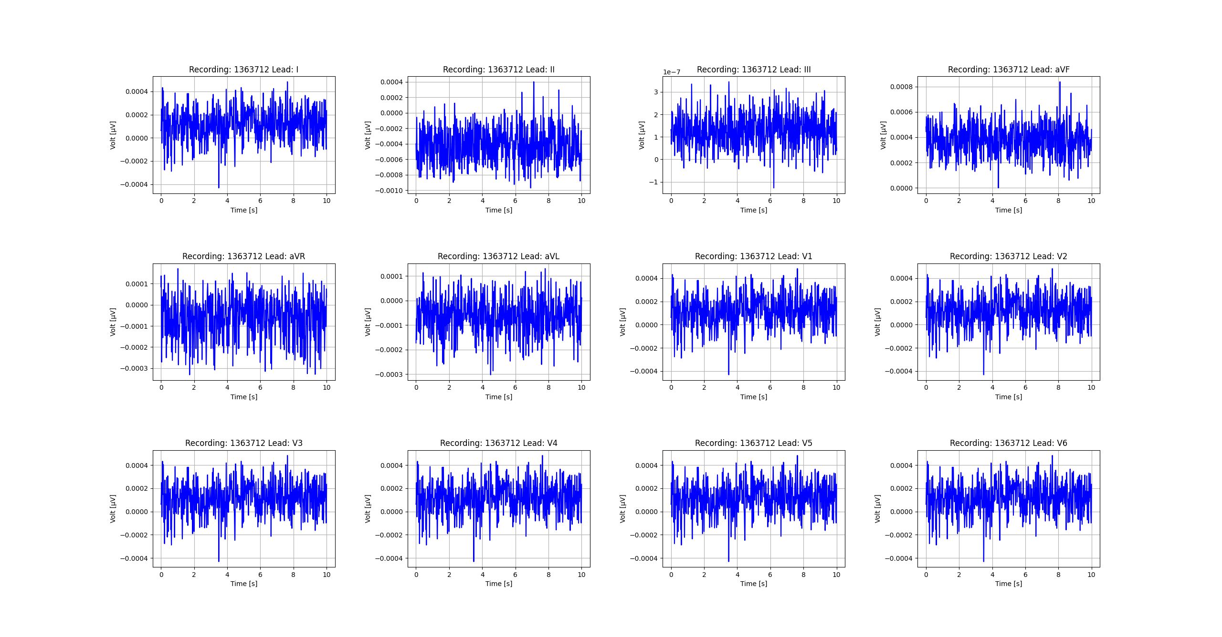
Figure_2

Slide 3
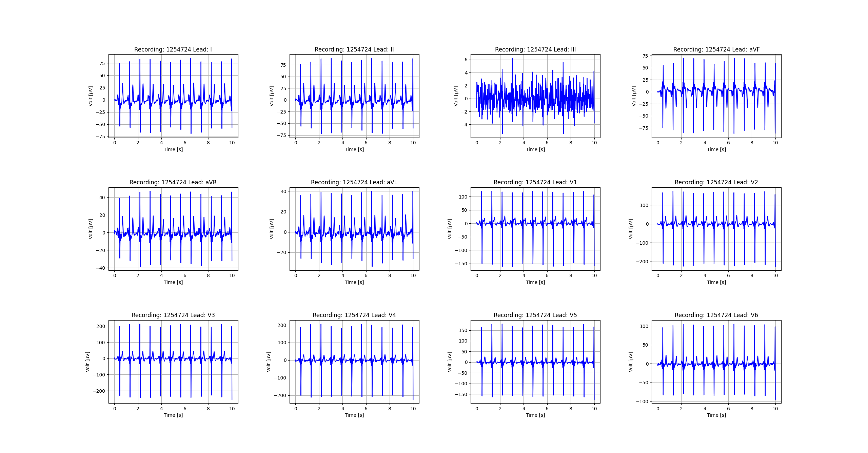
Figure_3

Slide 4
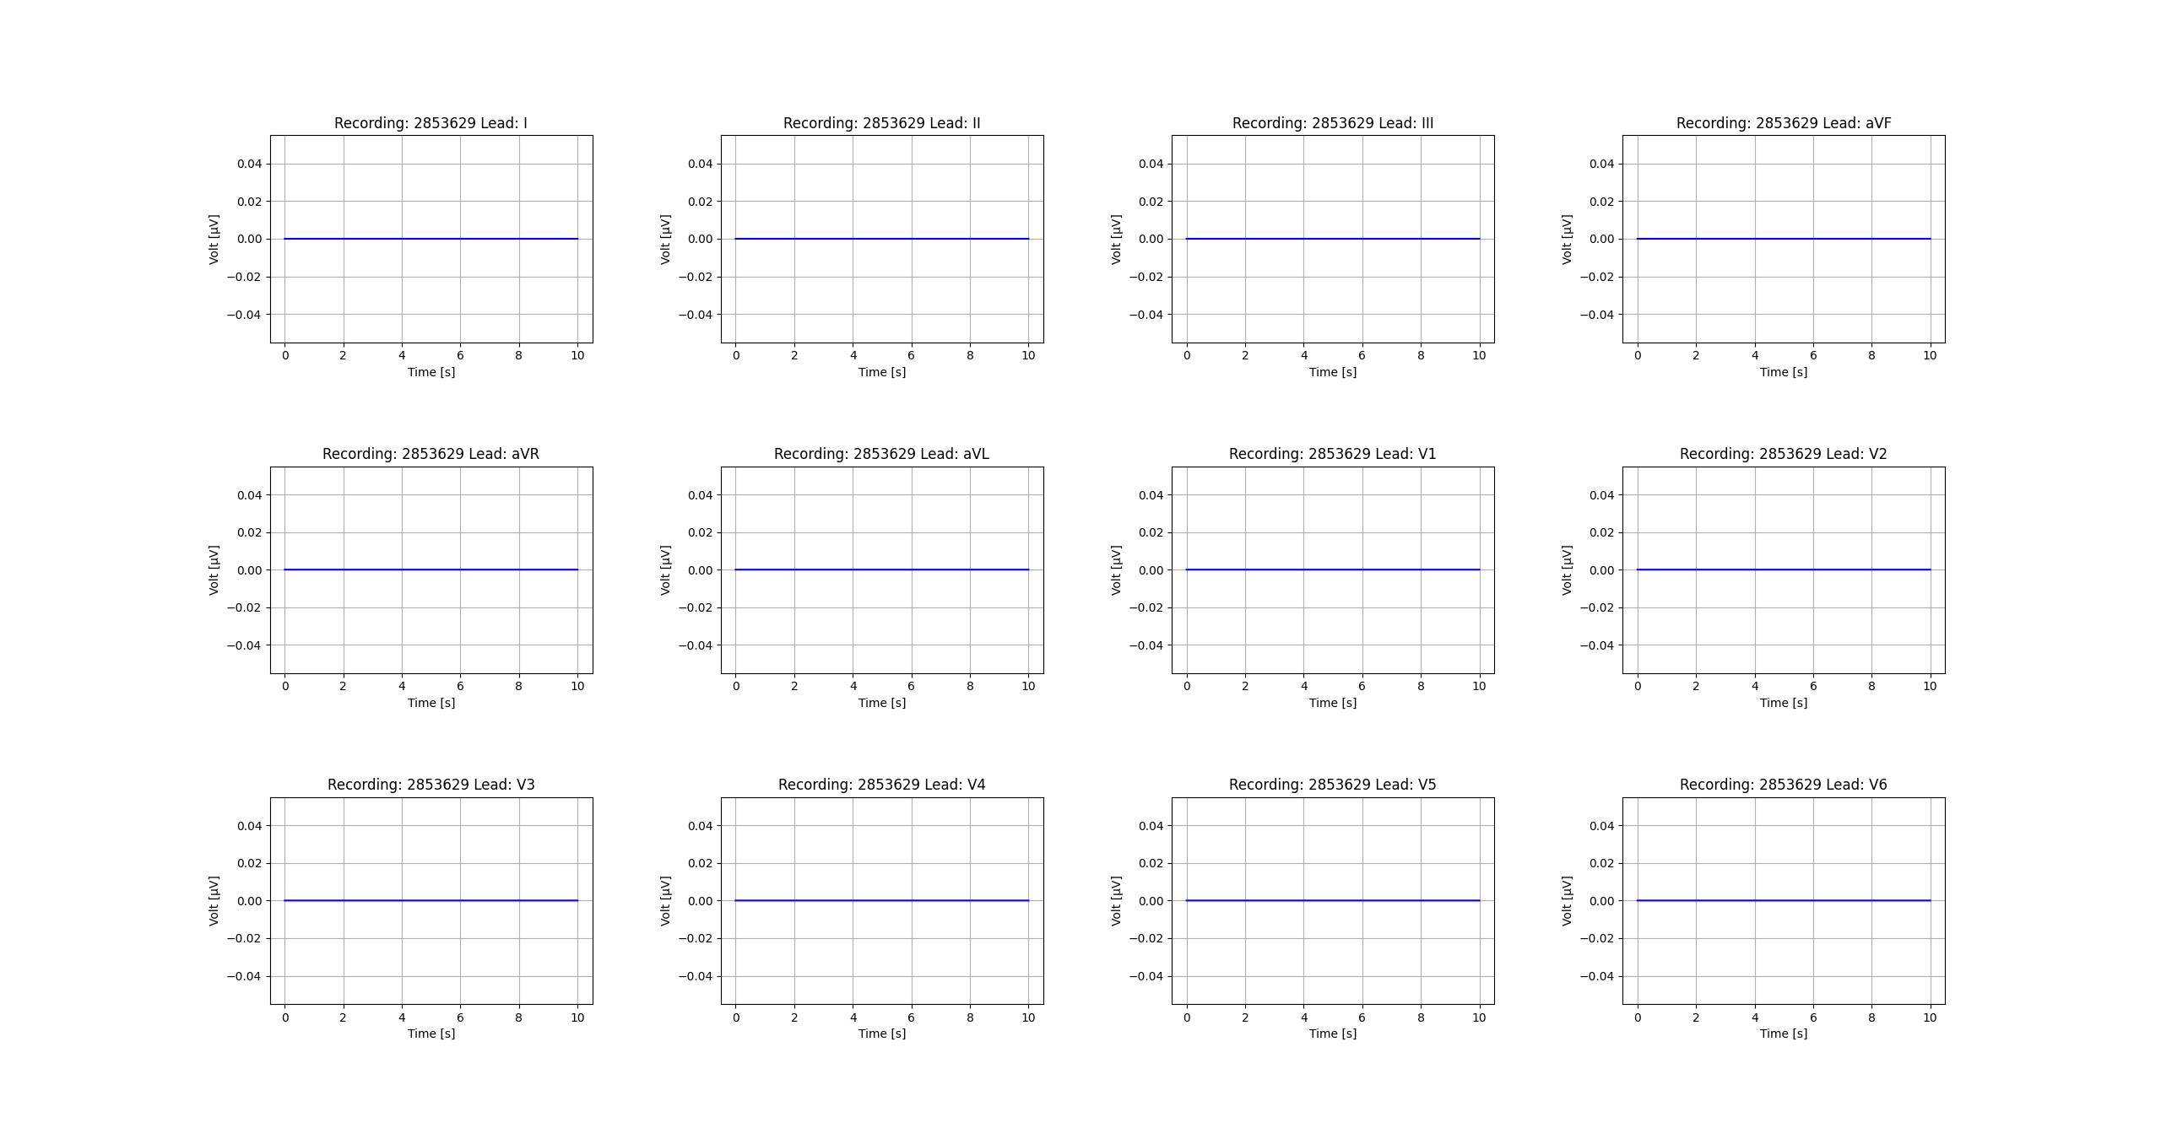
Figure_4

Slide 5
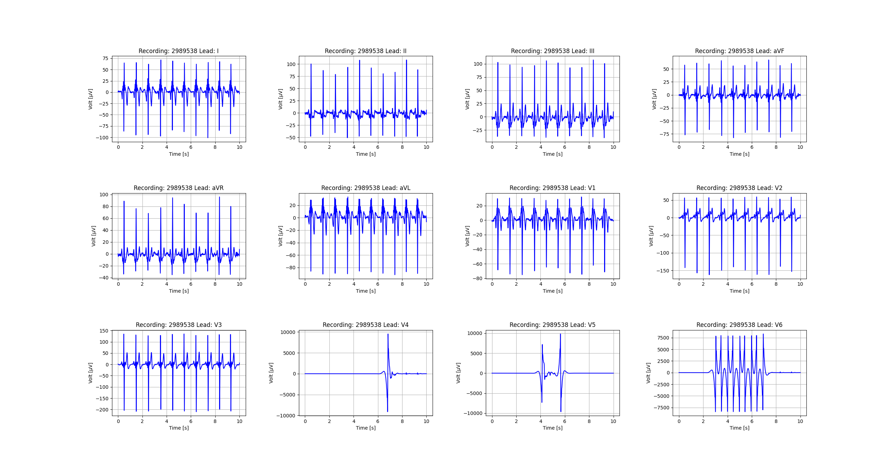
Figure_5

Slide 6
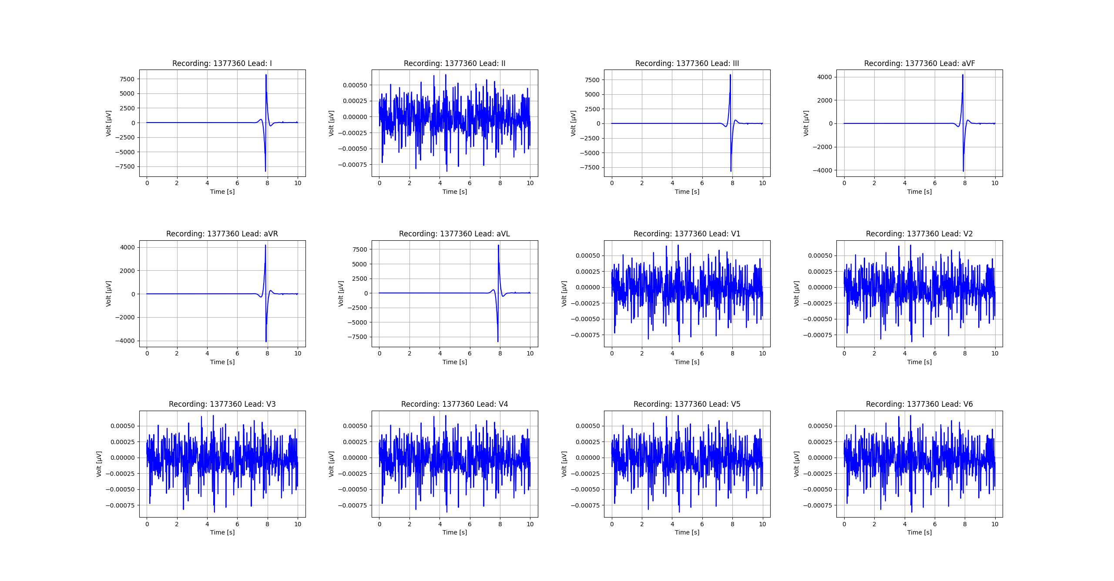
Figure_6

Slide 7
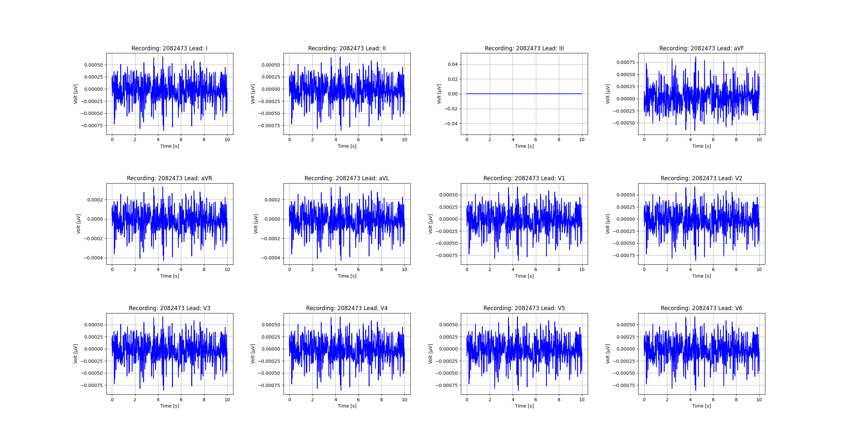
Figure_7

Slide 8
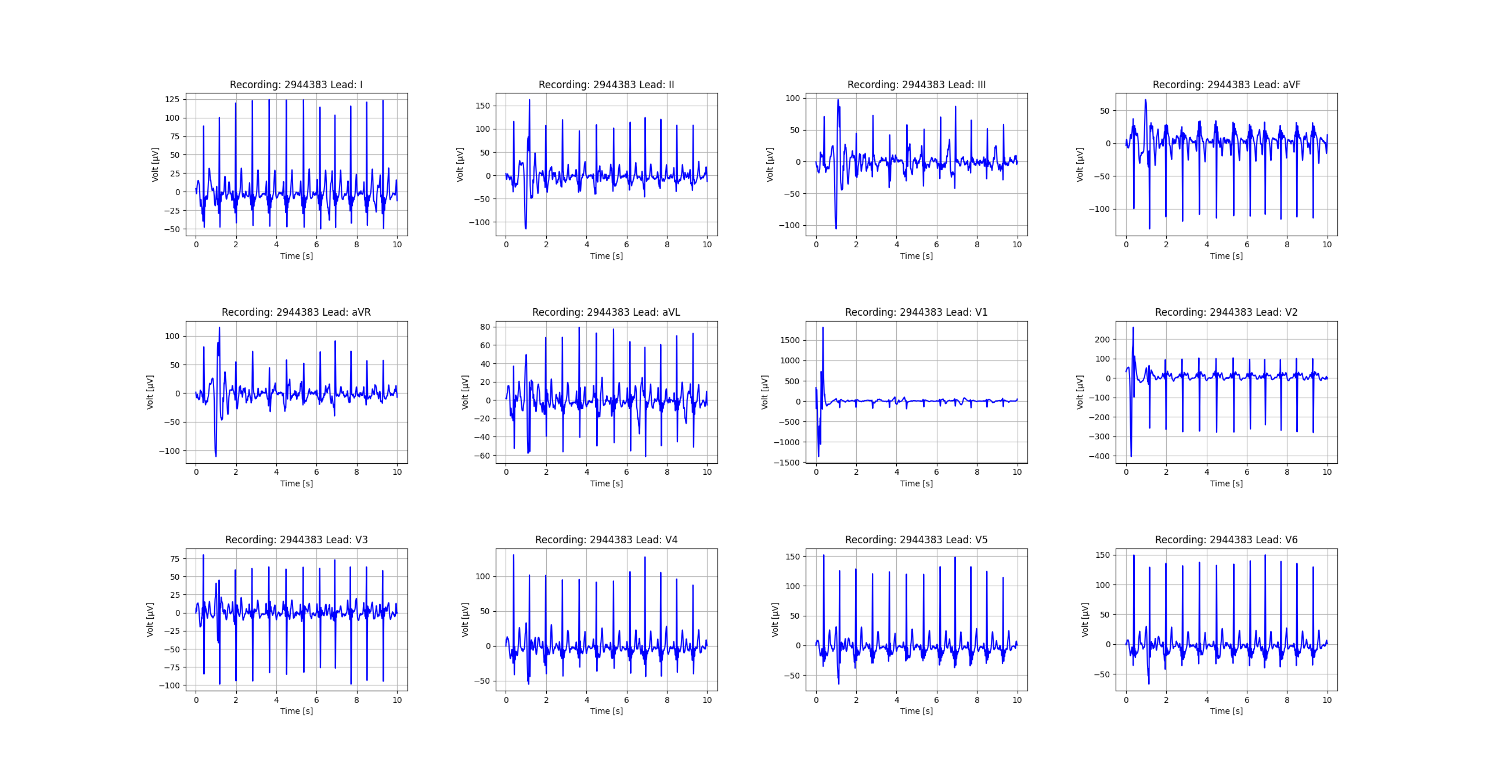
Figure_8

Slide 9
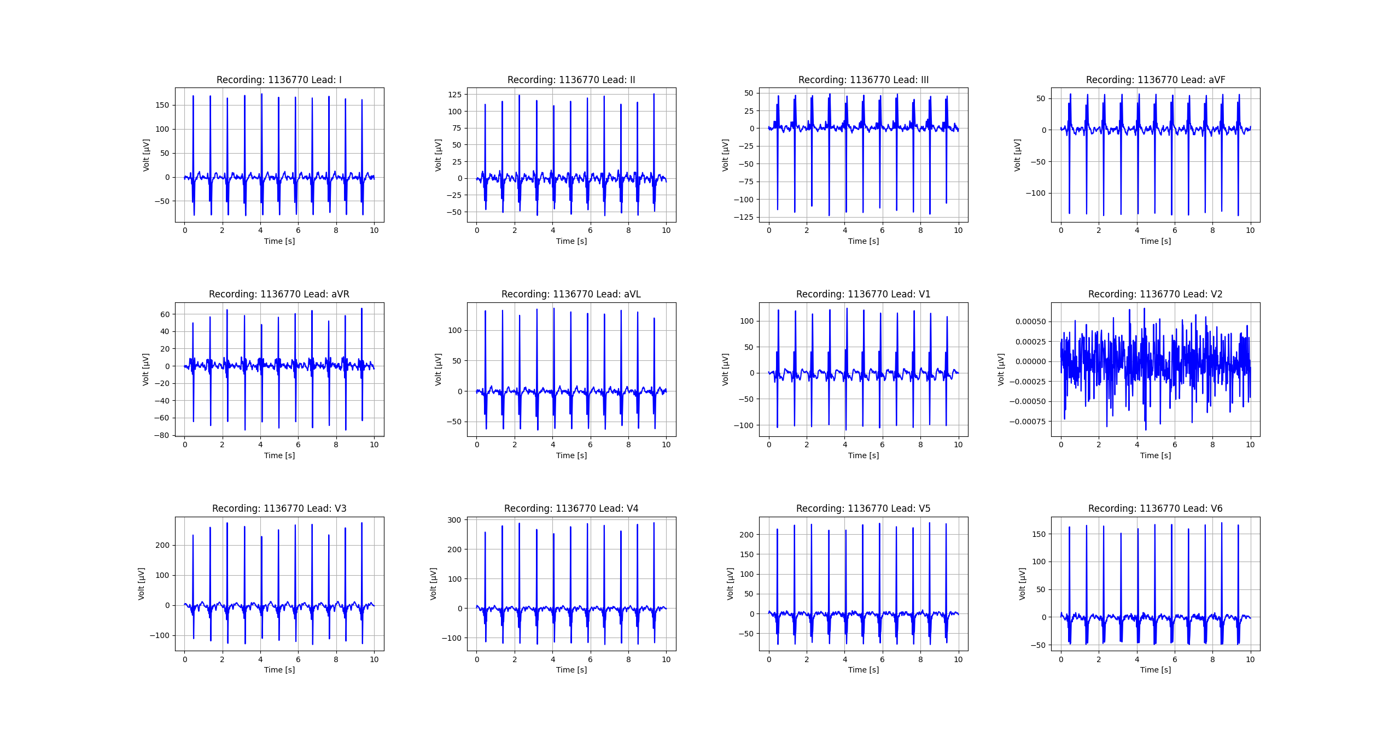
Figure_9

Slide 10
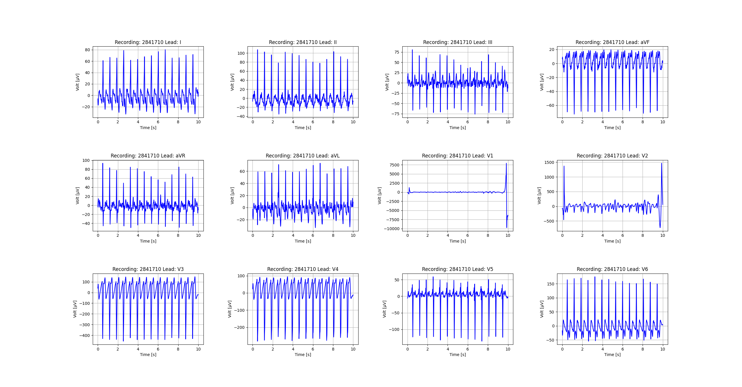
Figure_10

Slide 11
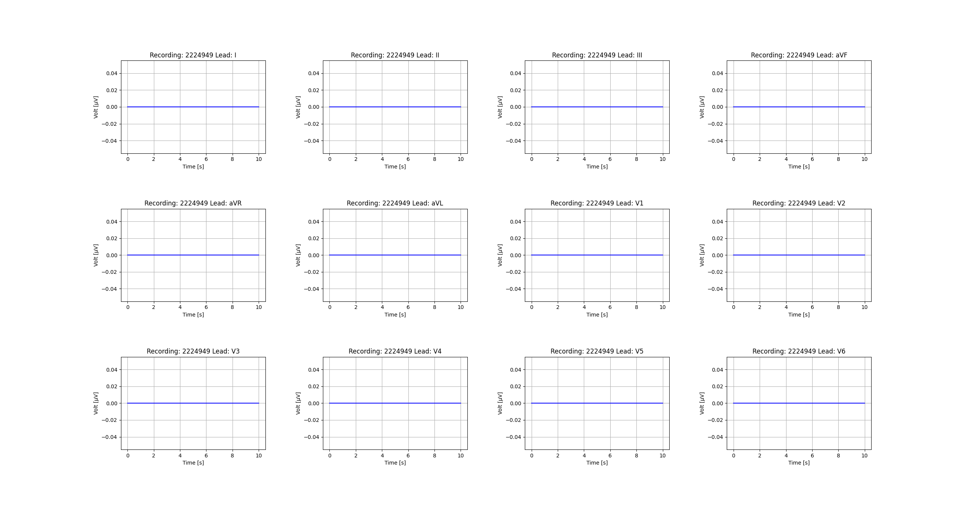
Figure_11

Slide 12

Figure_12

Slide 13
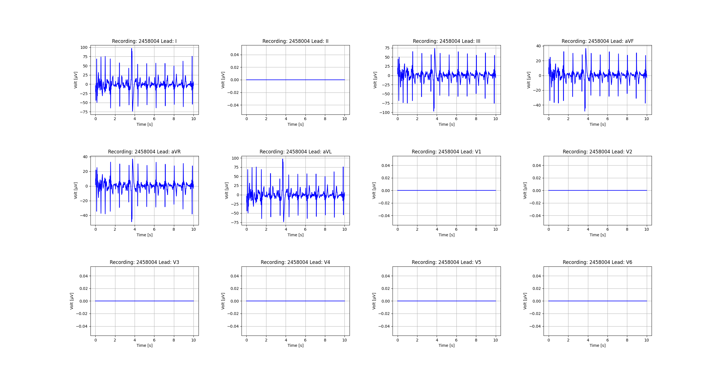
Figure_13

Slide 14
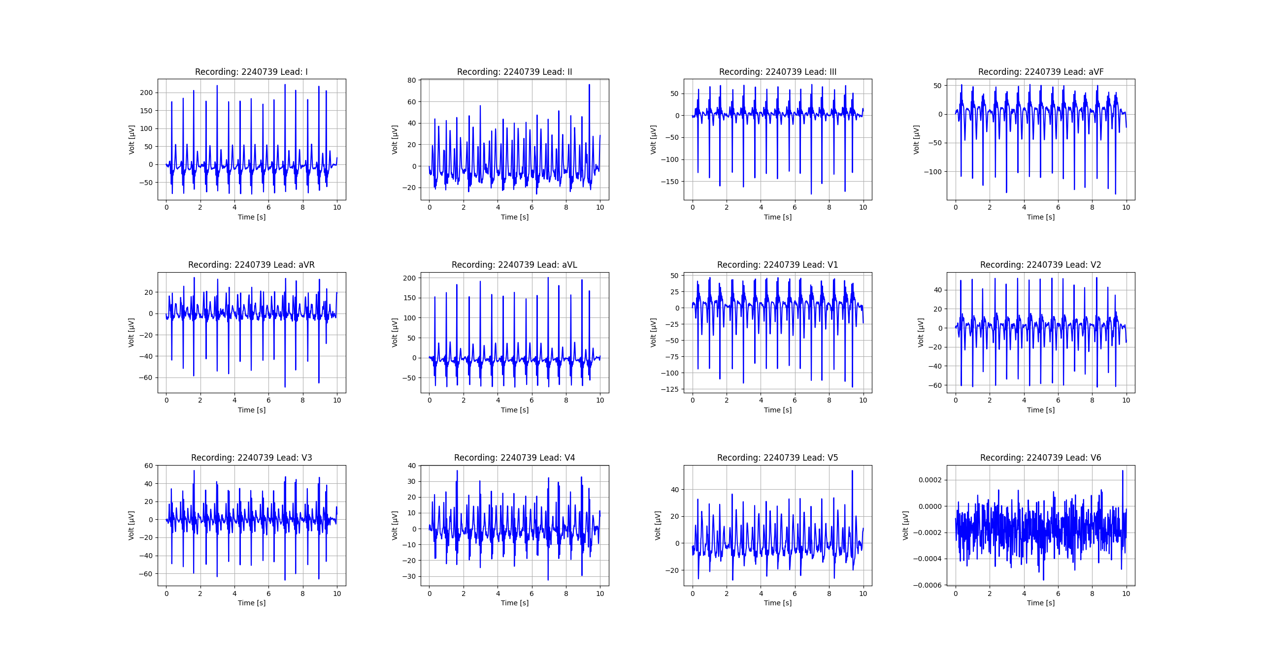
Figure_14

Slide 15
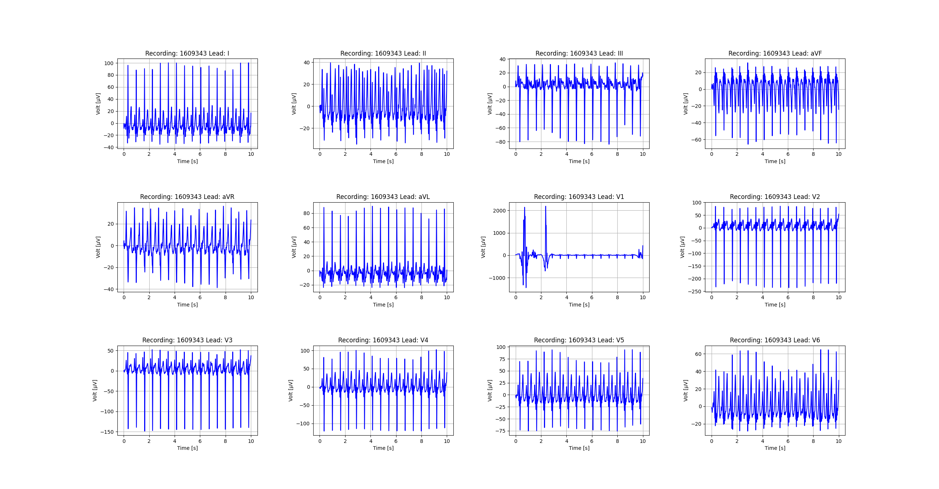
Figure_15

Slide 16
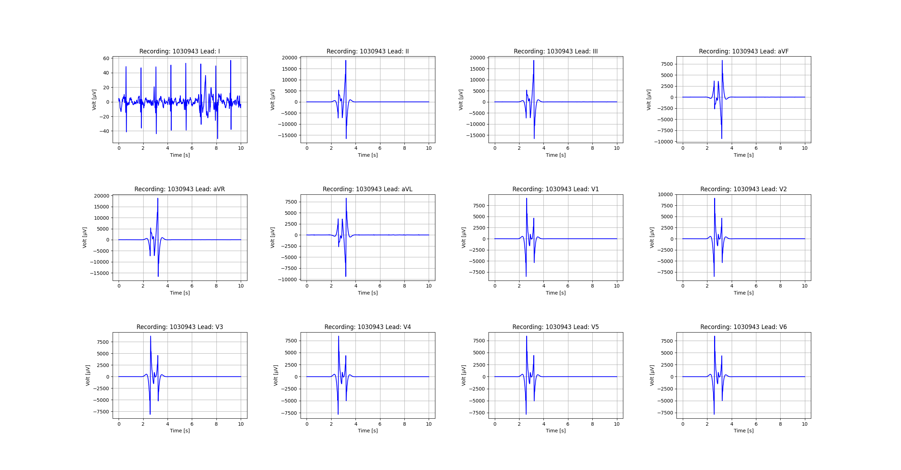
Figure_16

Slide 17
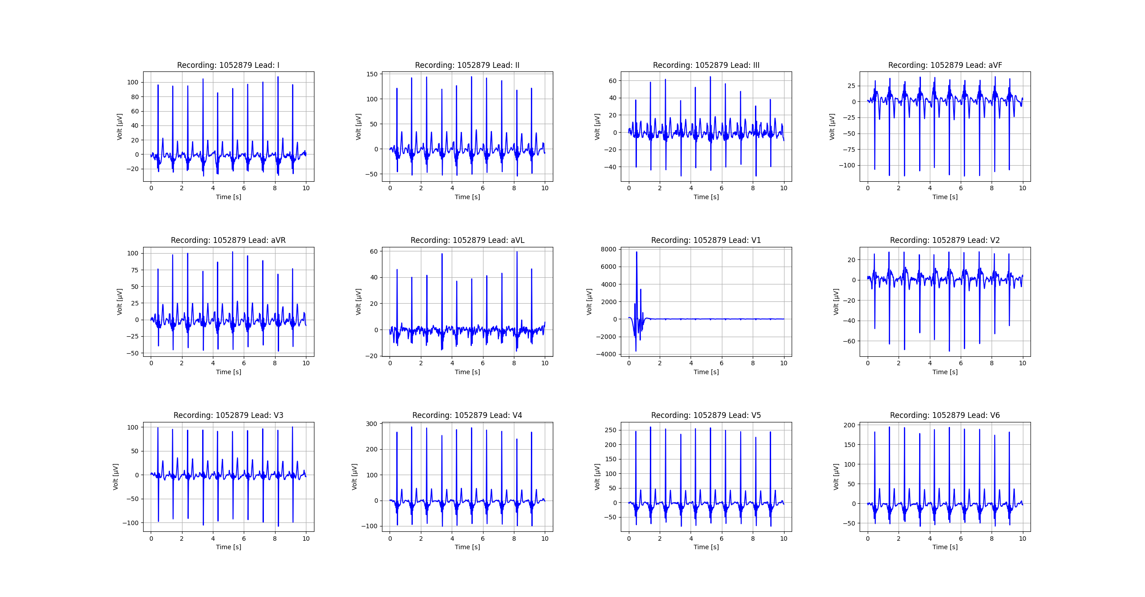
Figure_17

Slide 18
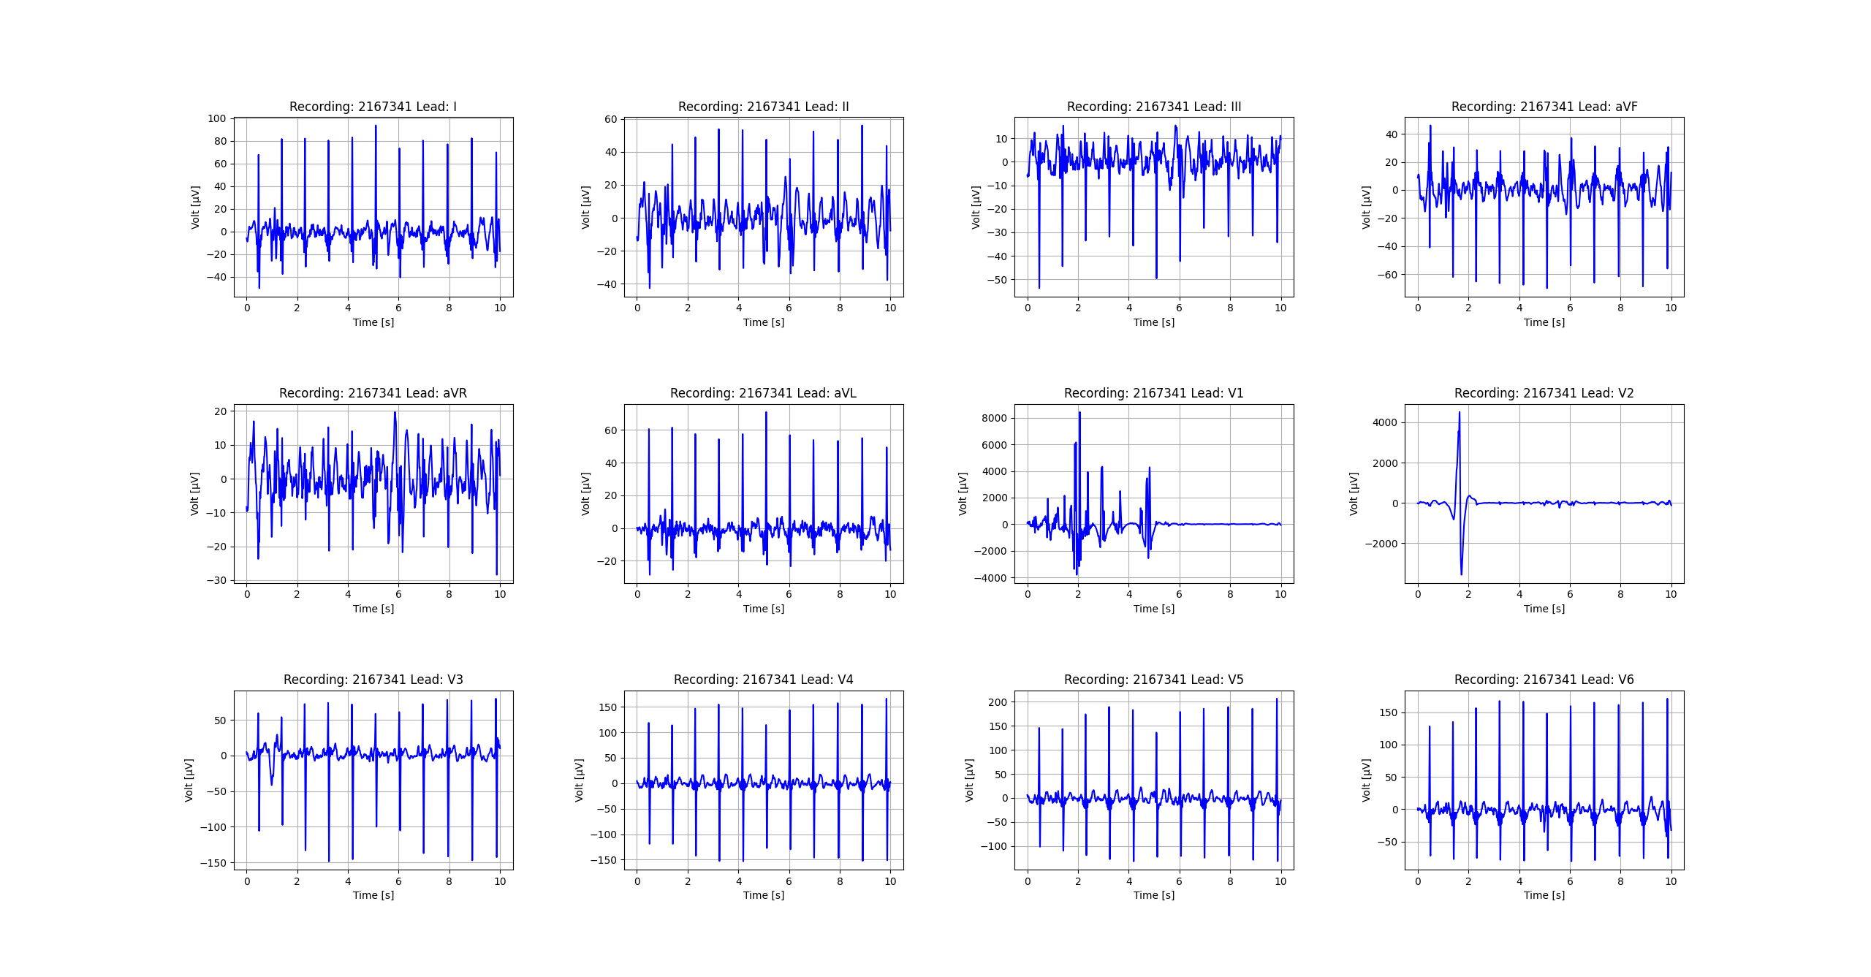
Figure_18

Slide 19

Figure_19

Slide 20

Figure_20

Slide 21
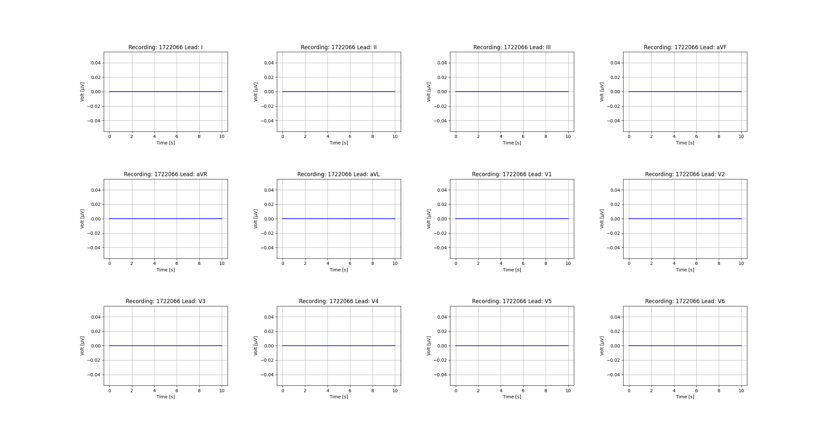
Figure_21

Slide 22
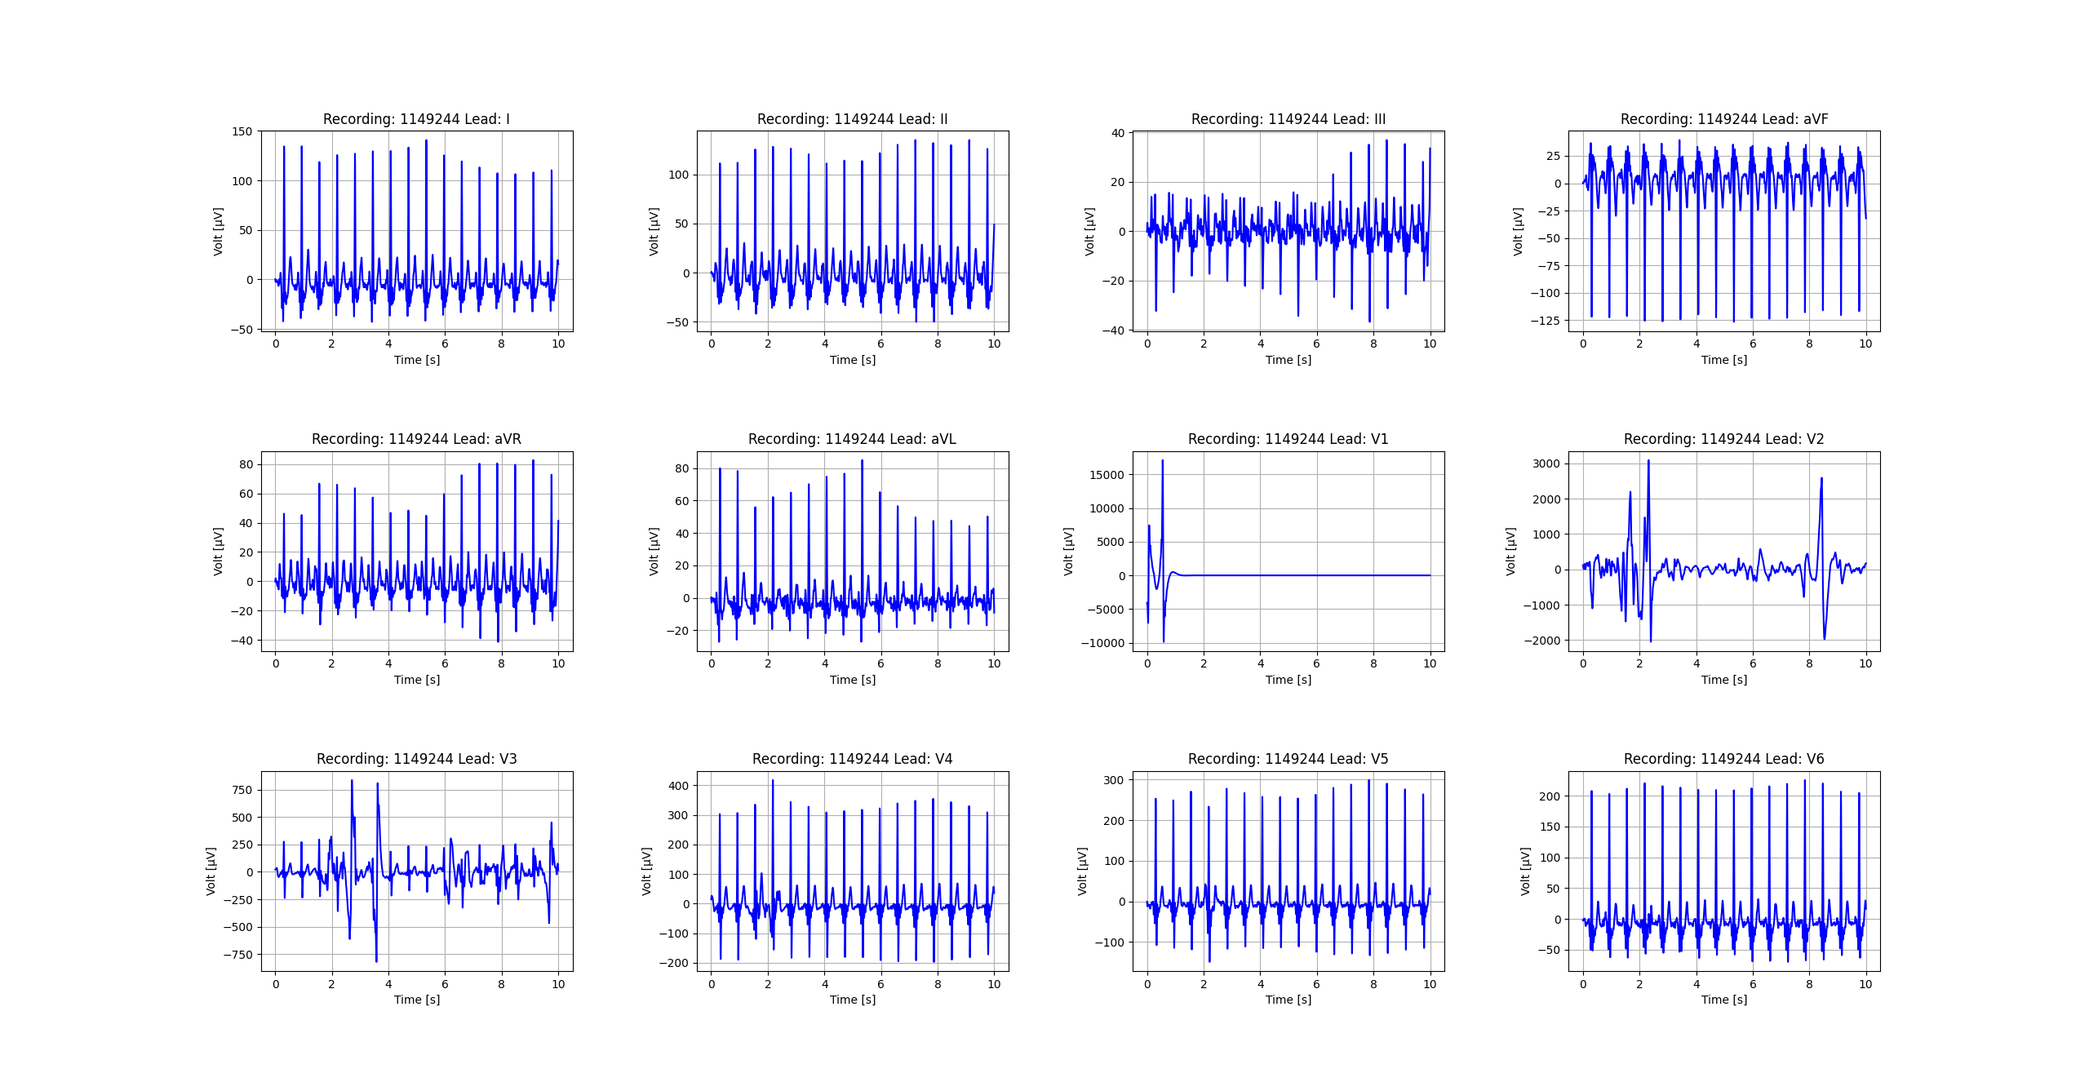
Figure_22

Slide 23
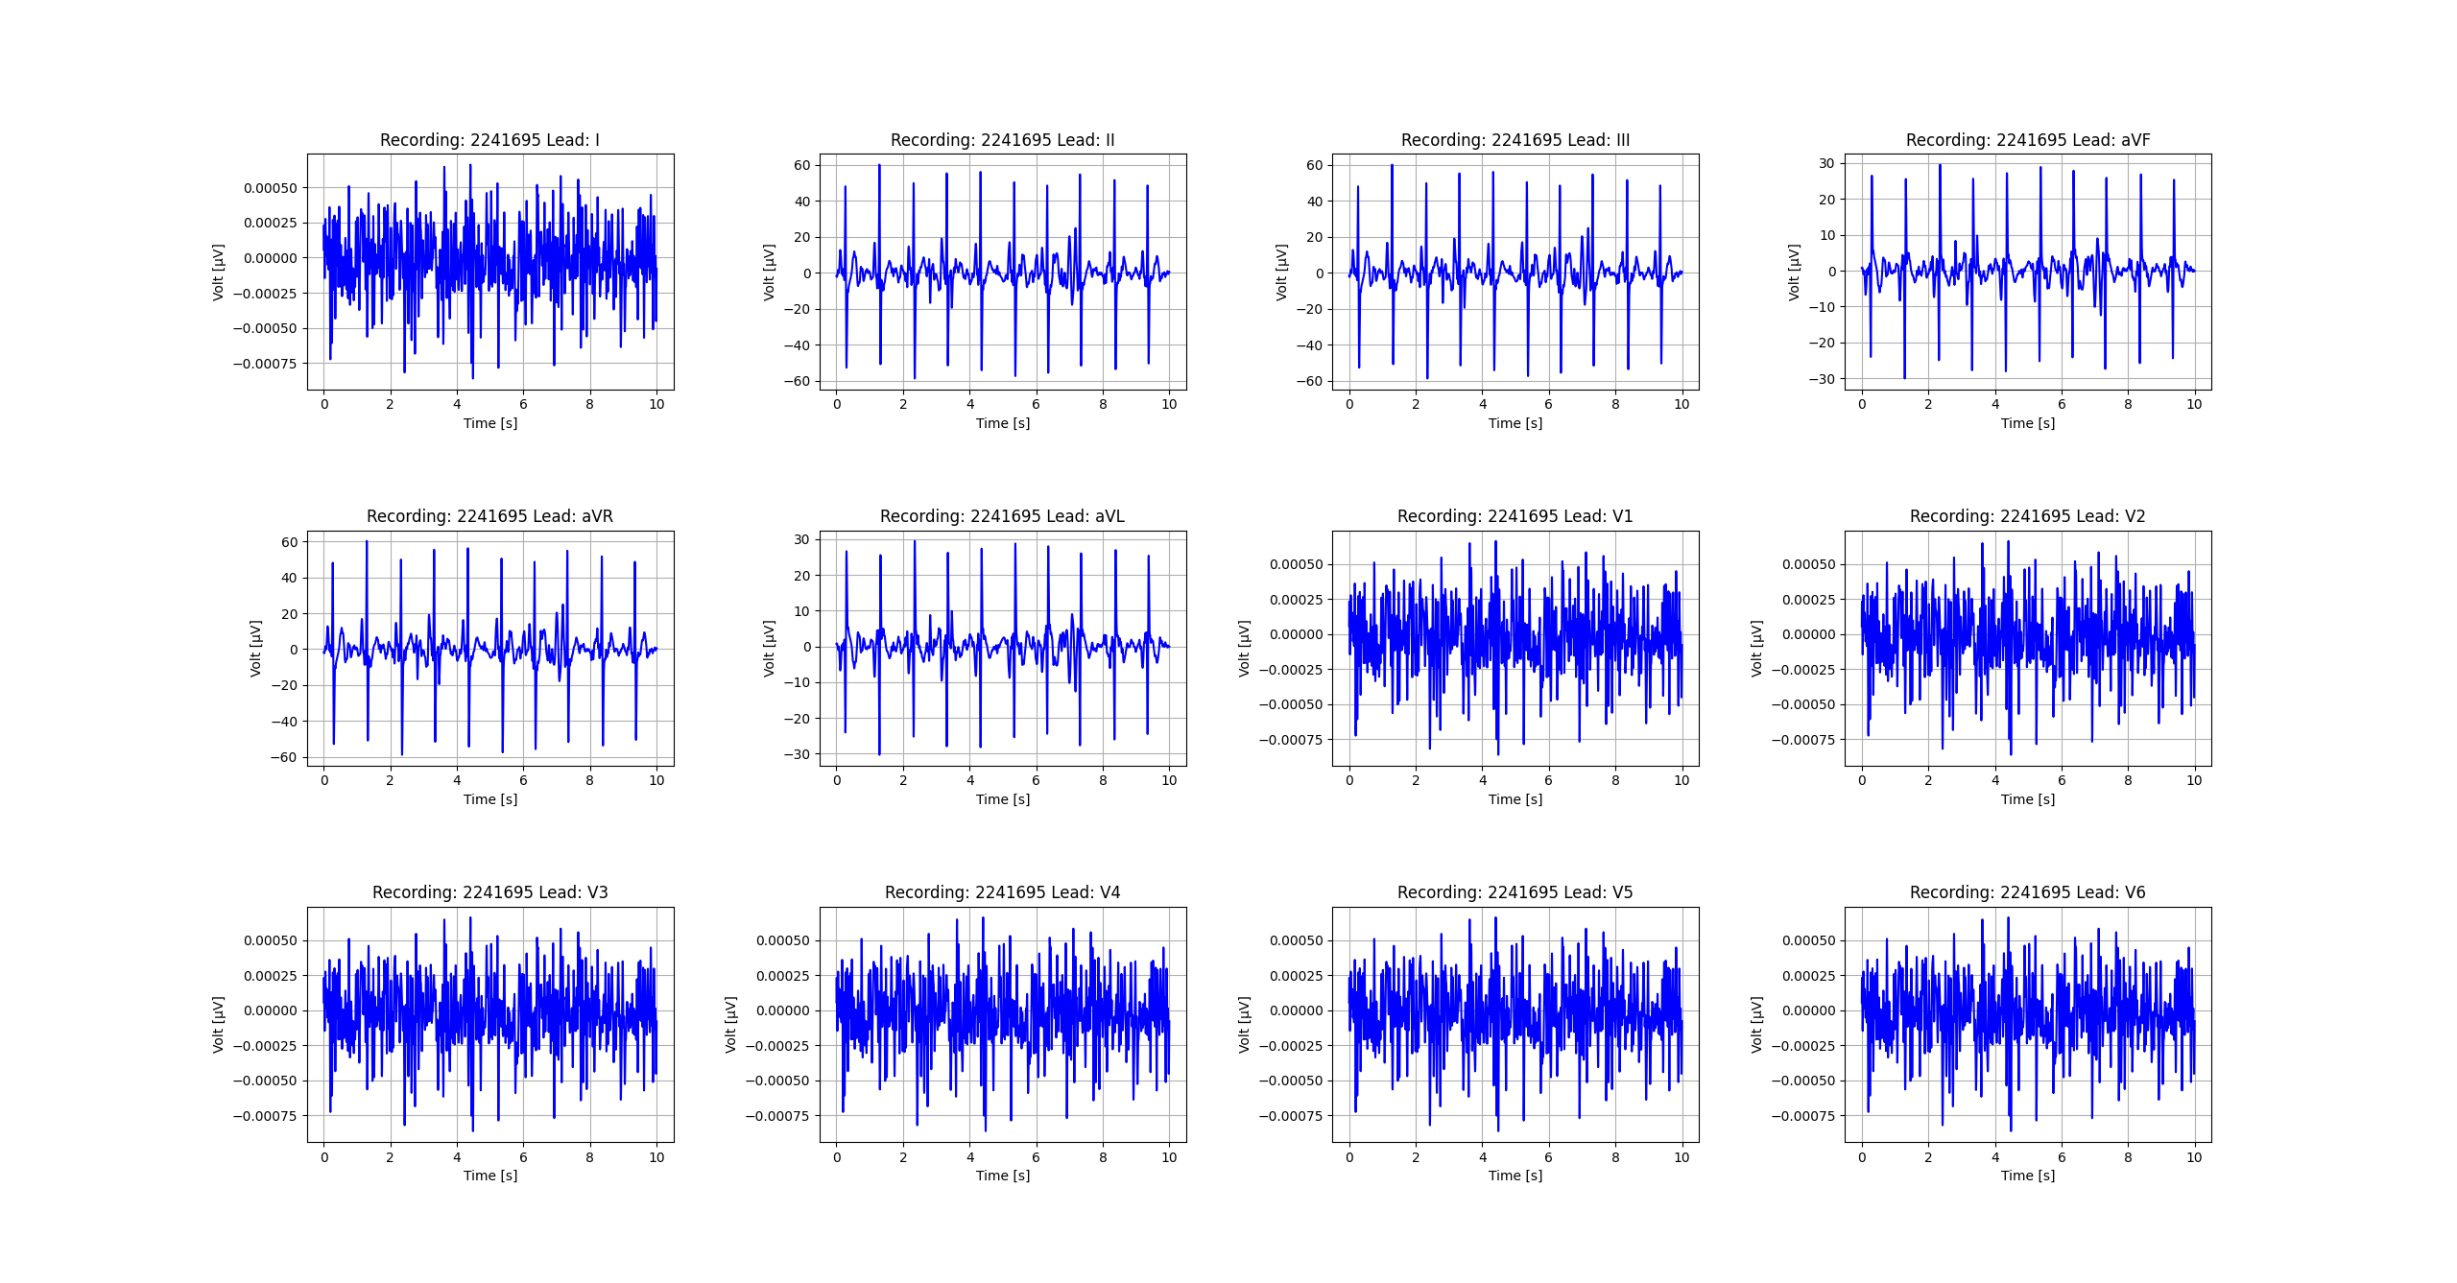
Figure_23

Slide 24
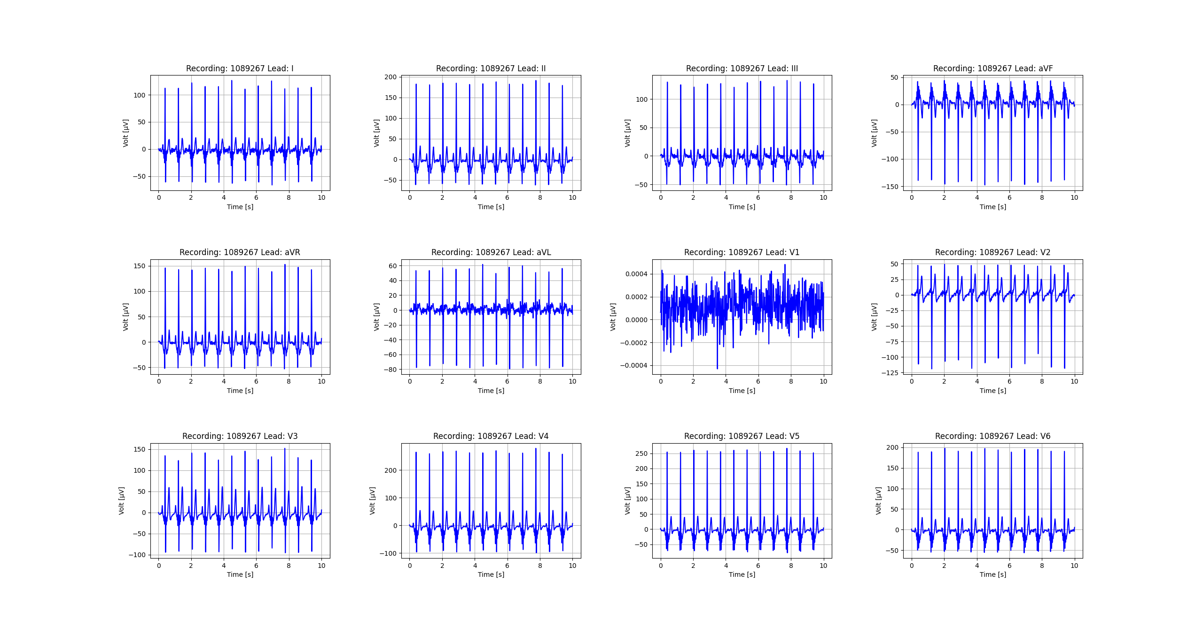
Figure_24

Slide 25
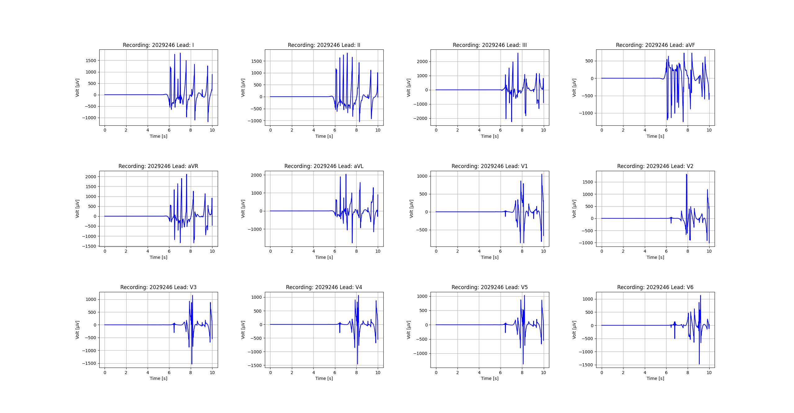
Figure_25

Slide 26
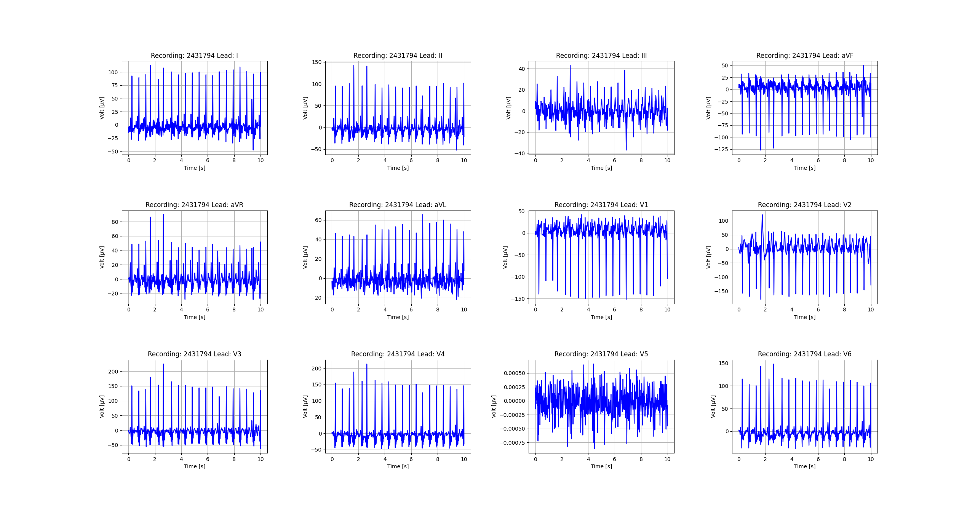
Figure_26

Slide 27
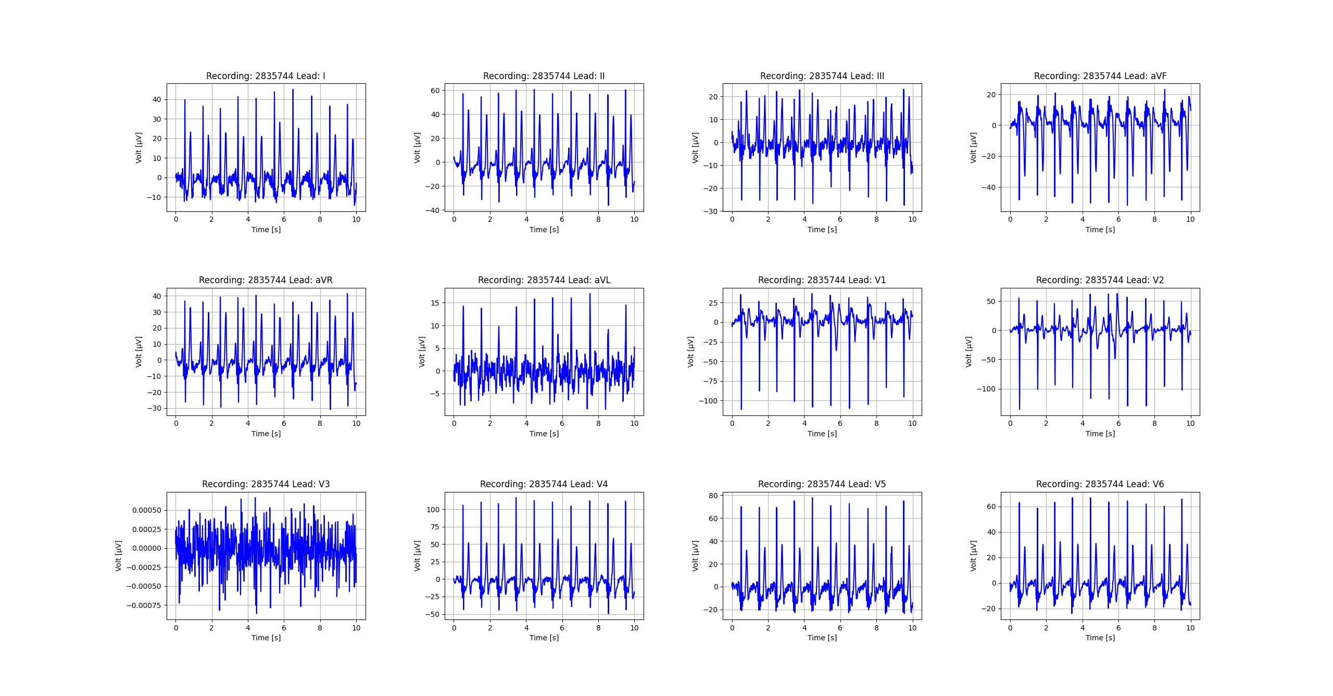
Figure_27

Slide 28
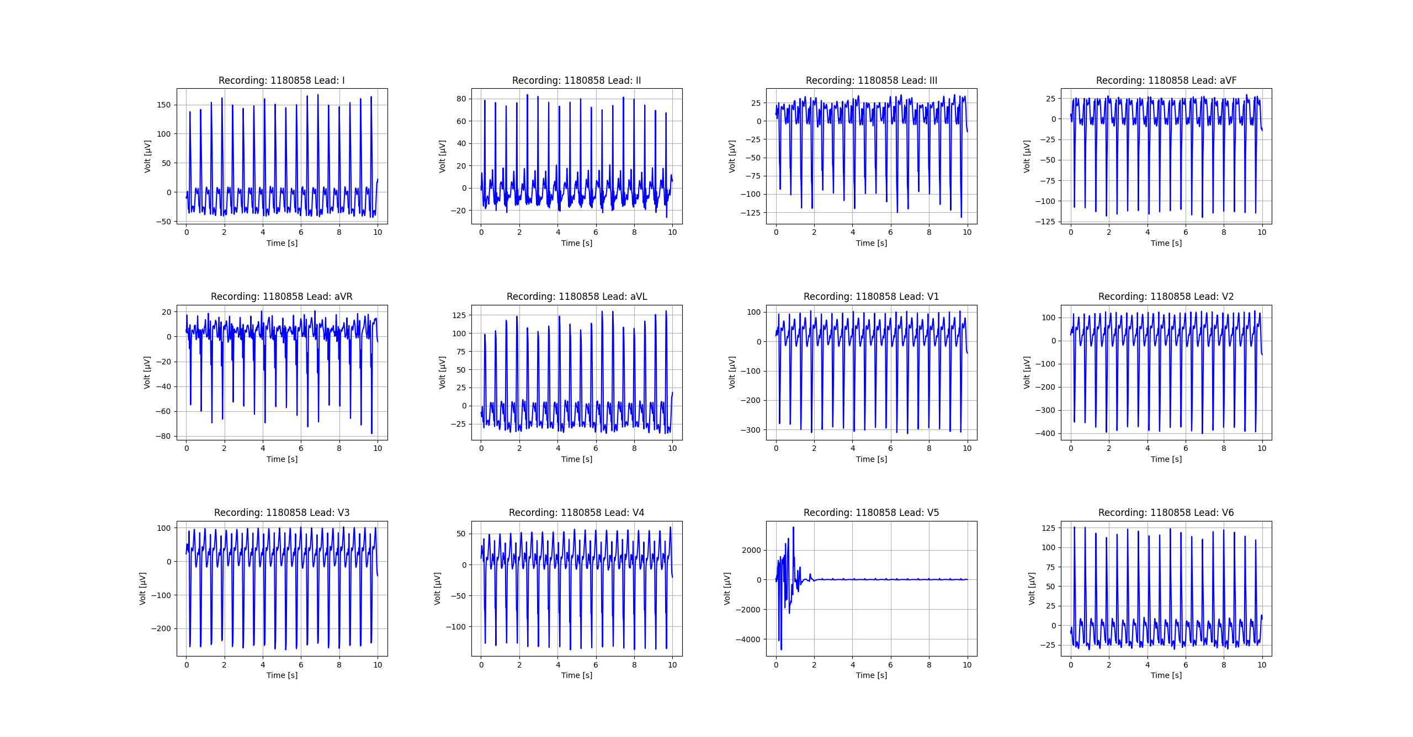
Figure_28

Slide 29
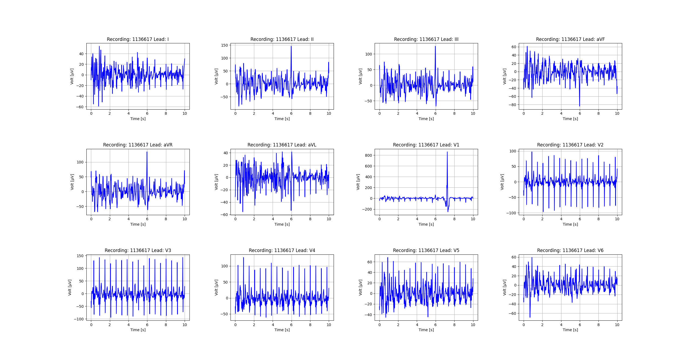
Figure_29

Slide 30
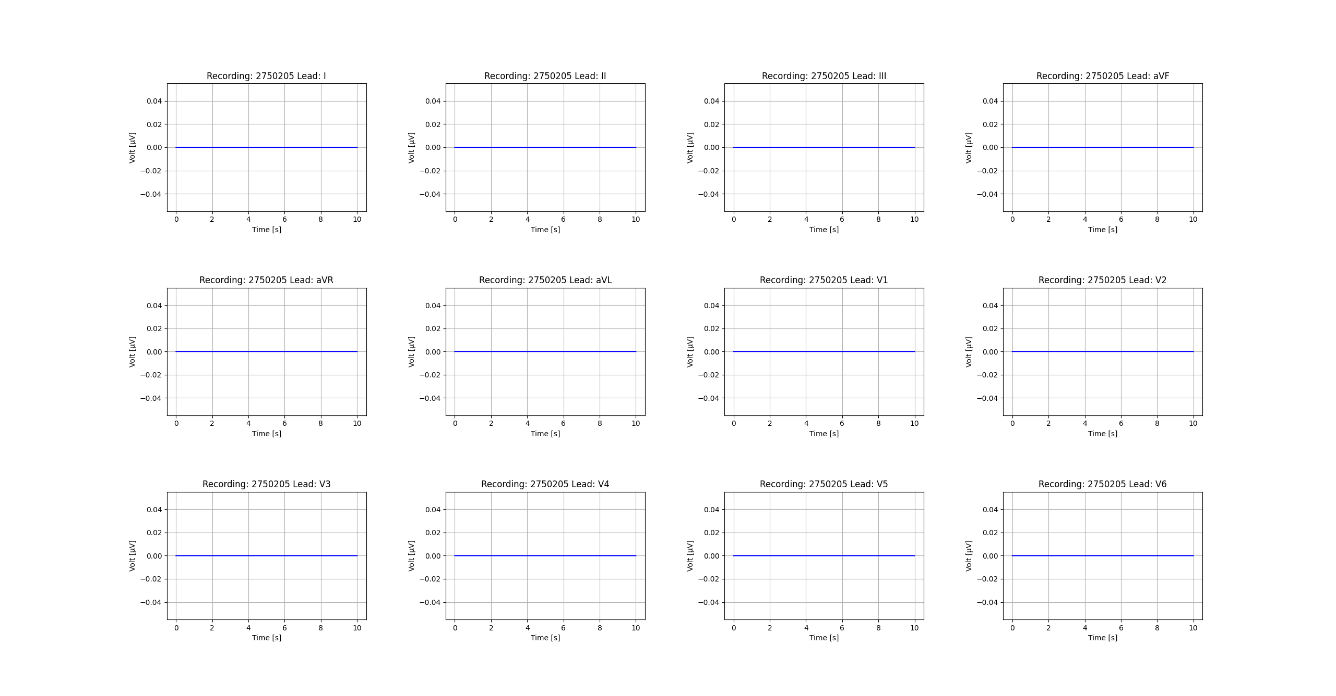
Figure_30

Slide 31

Figure_31

Slide 32
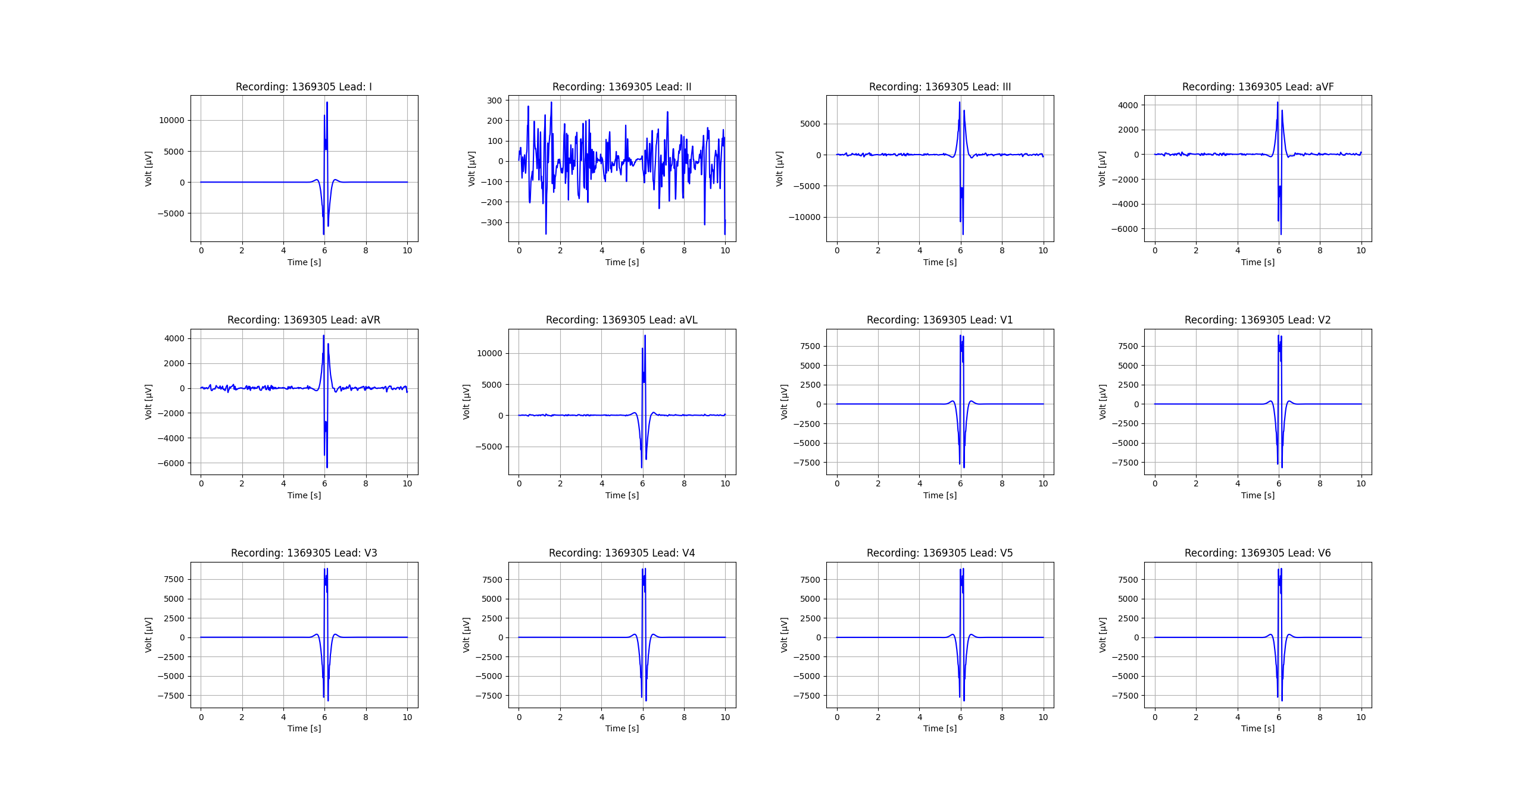
Figure_32

Slide 33
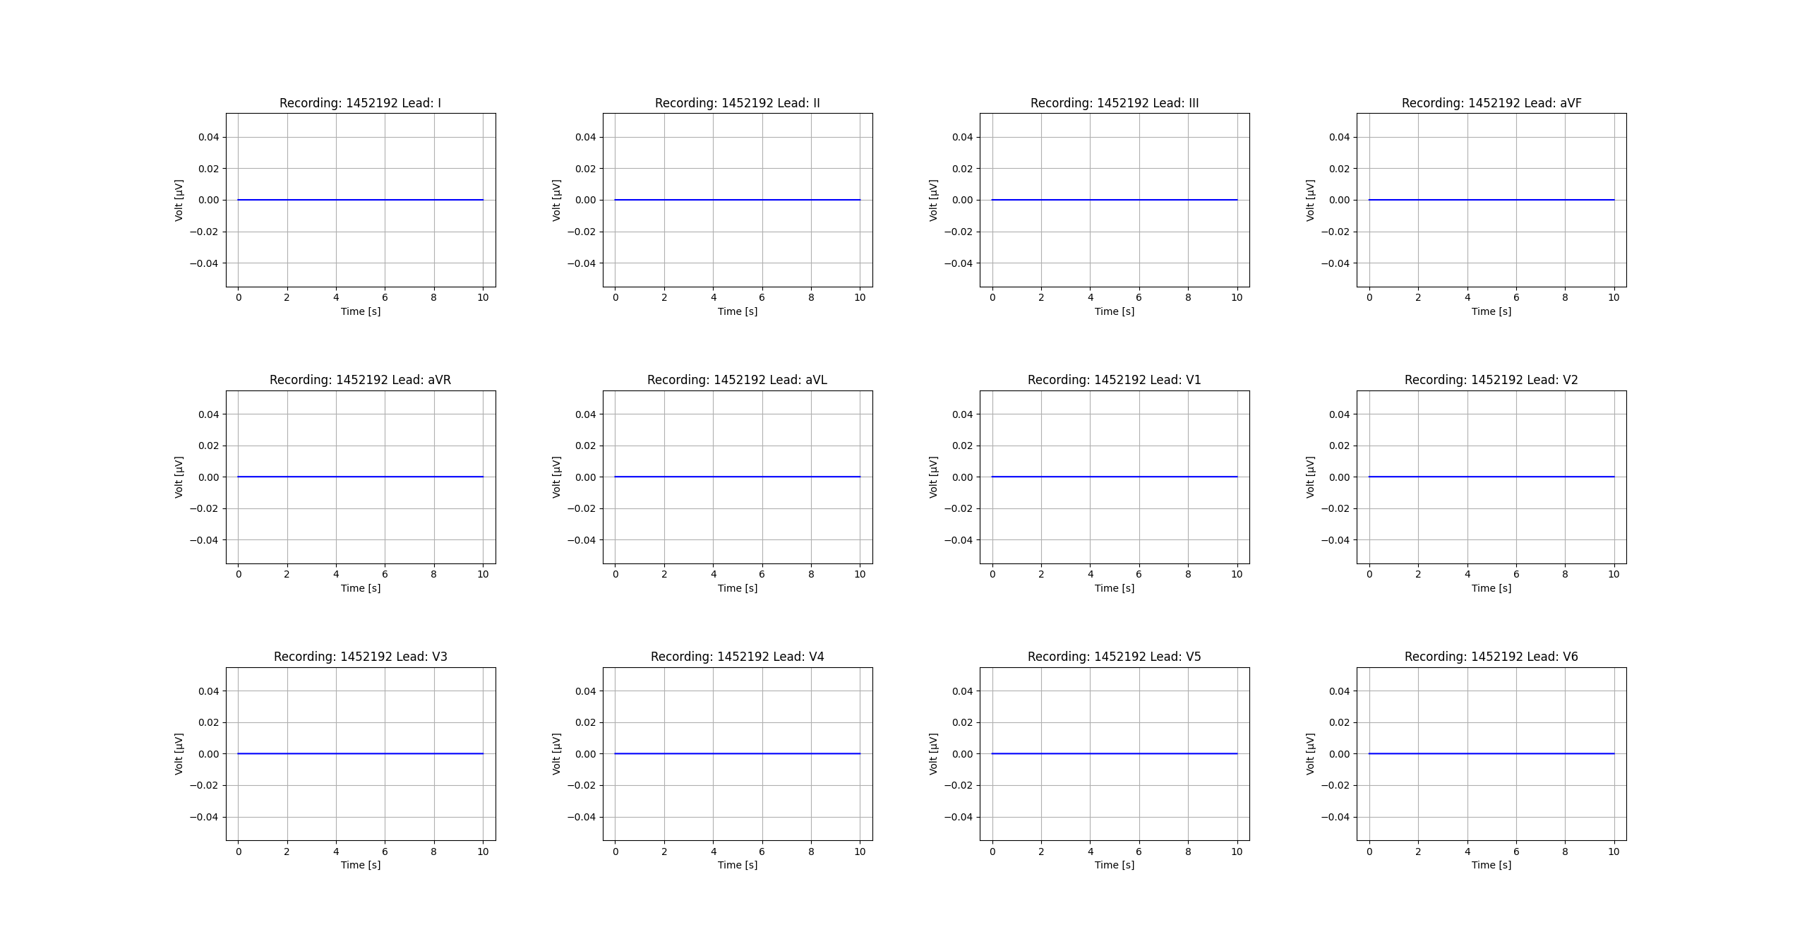
Figure_33

Slide 34

Figure_34

Slide 35

Figure_35

Slide 36
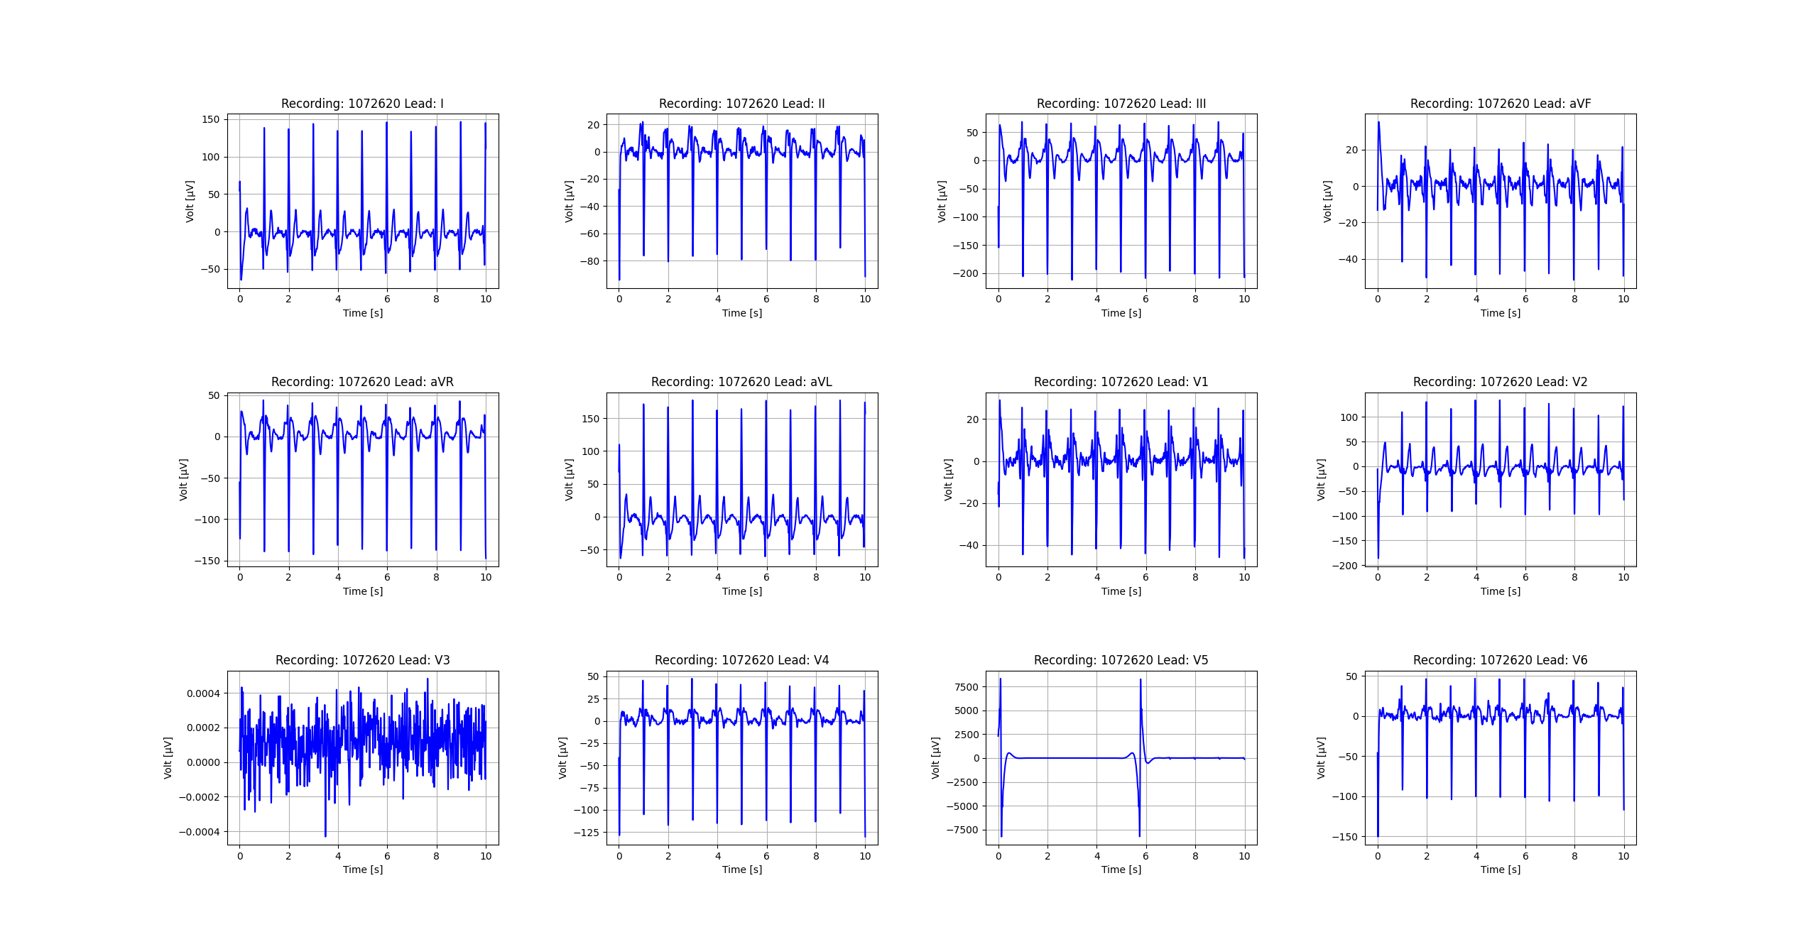
Figure_36

Slide 37
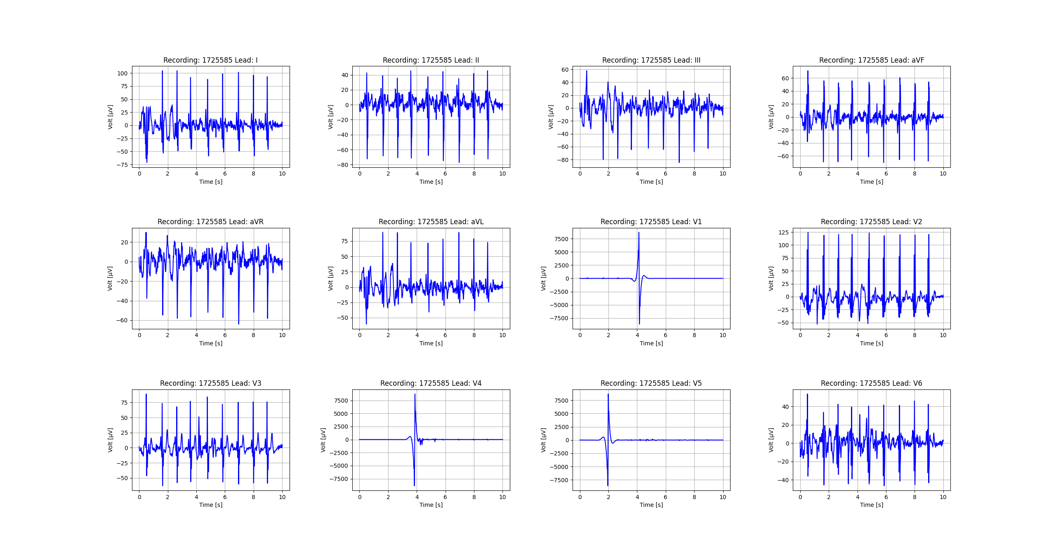
Figure_37

Slide 38
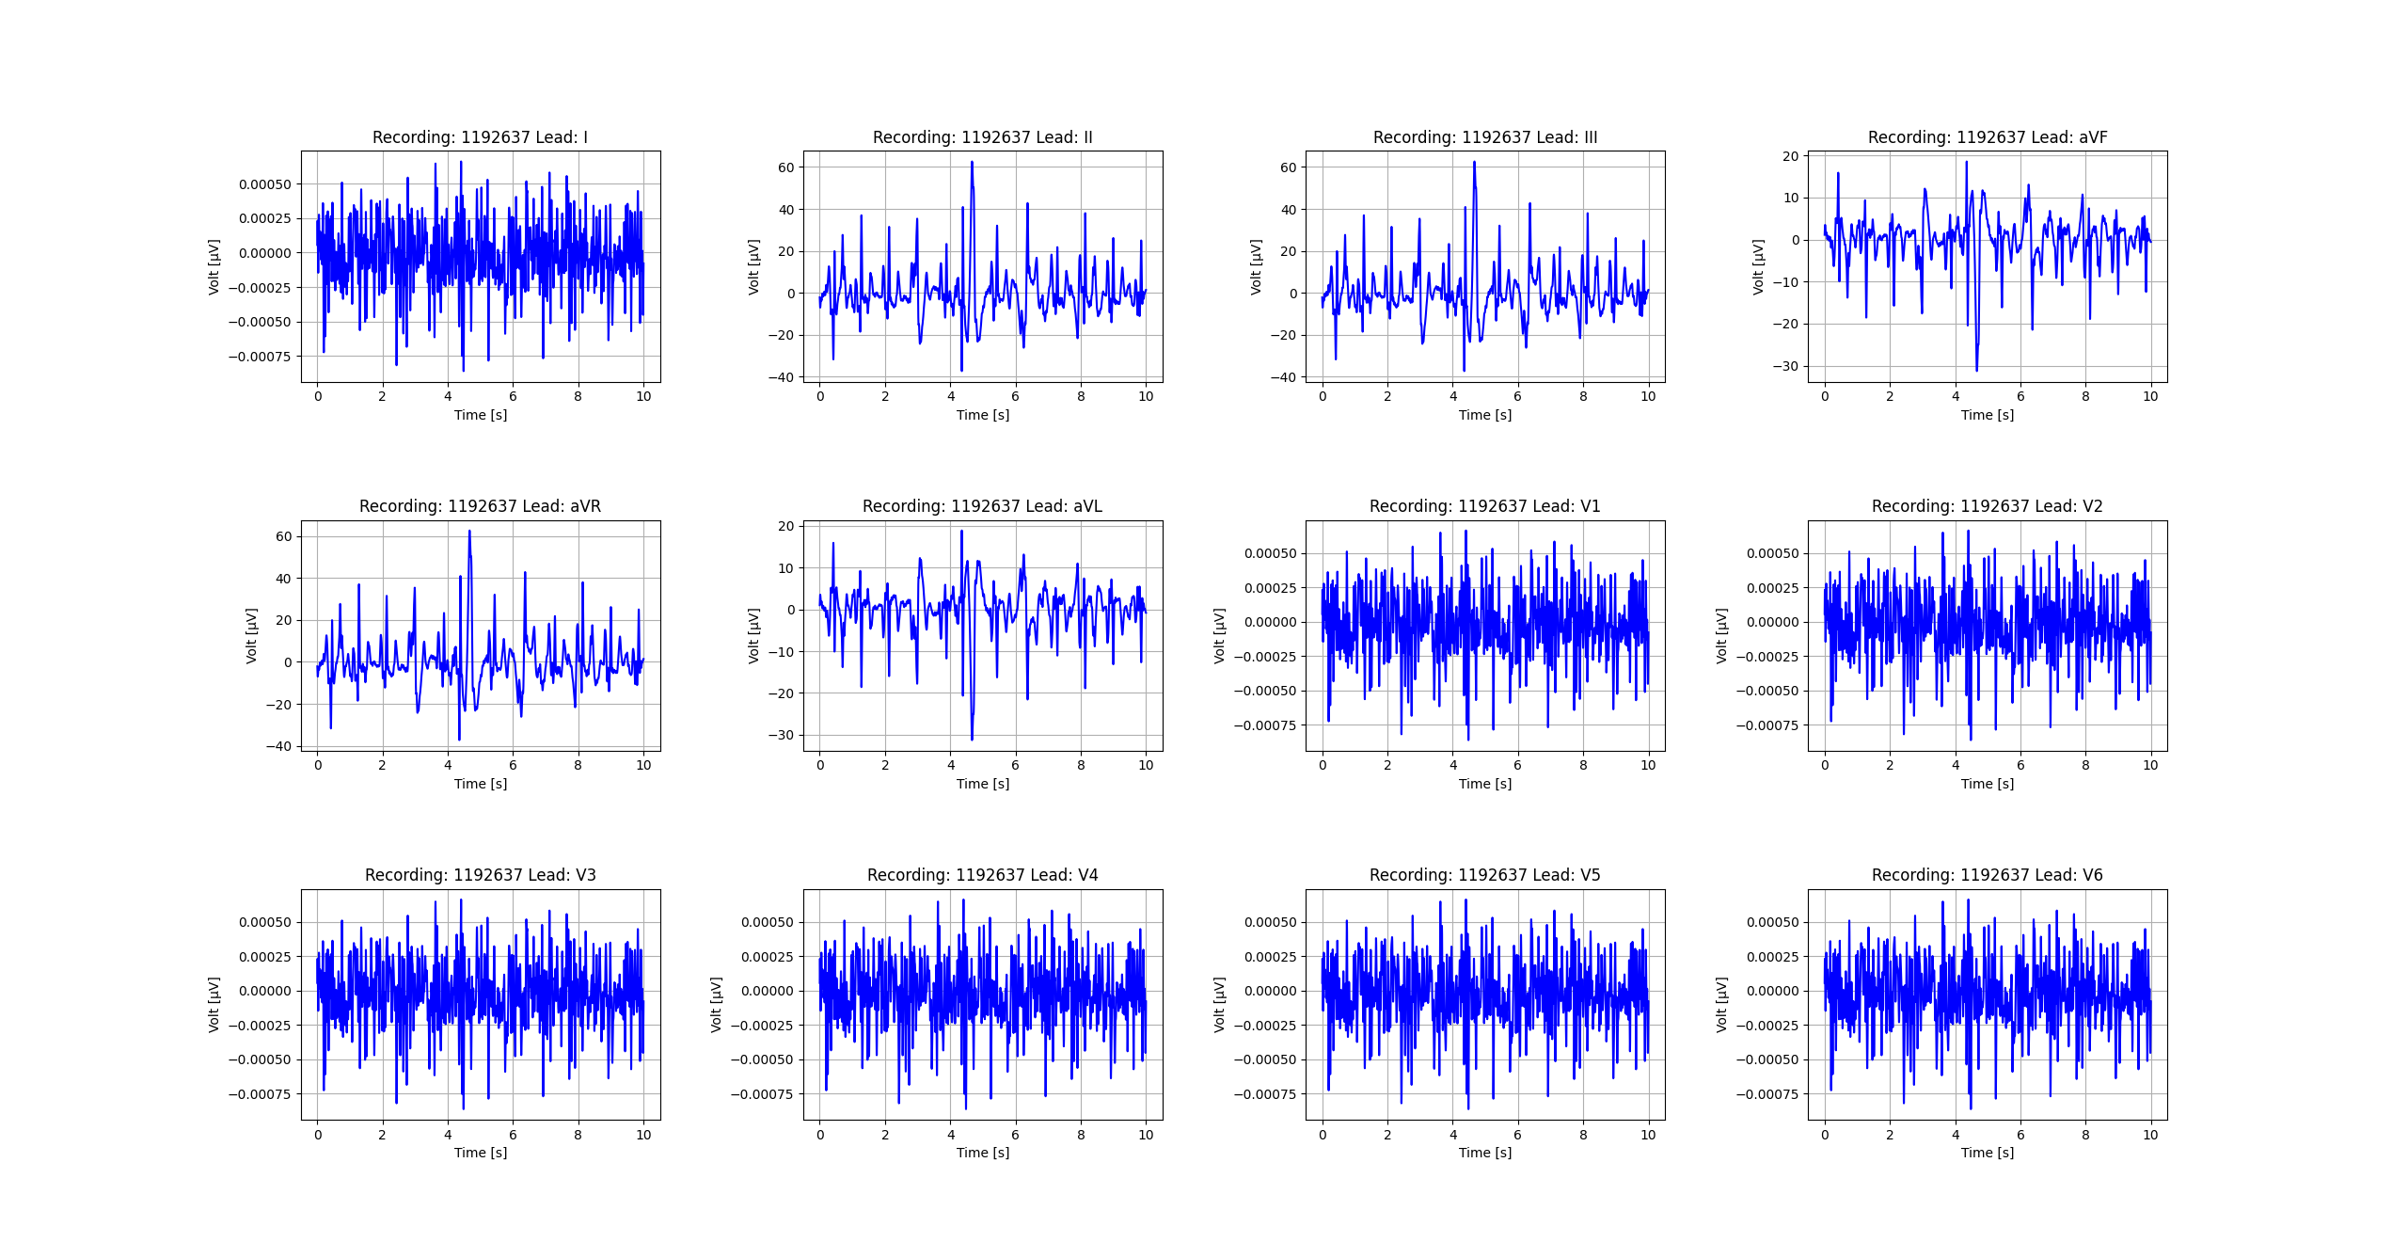
Figure_38

Slide 39
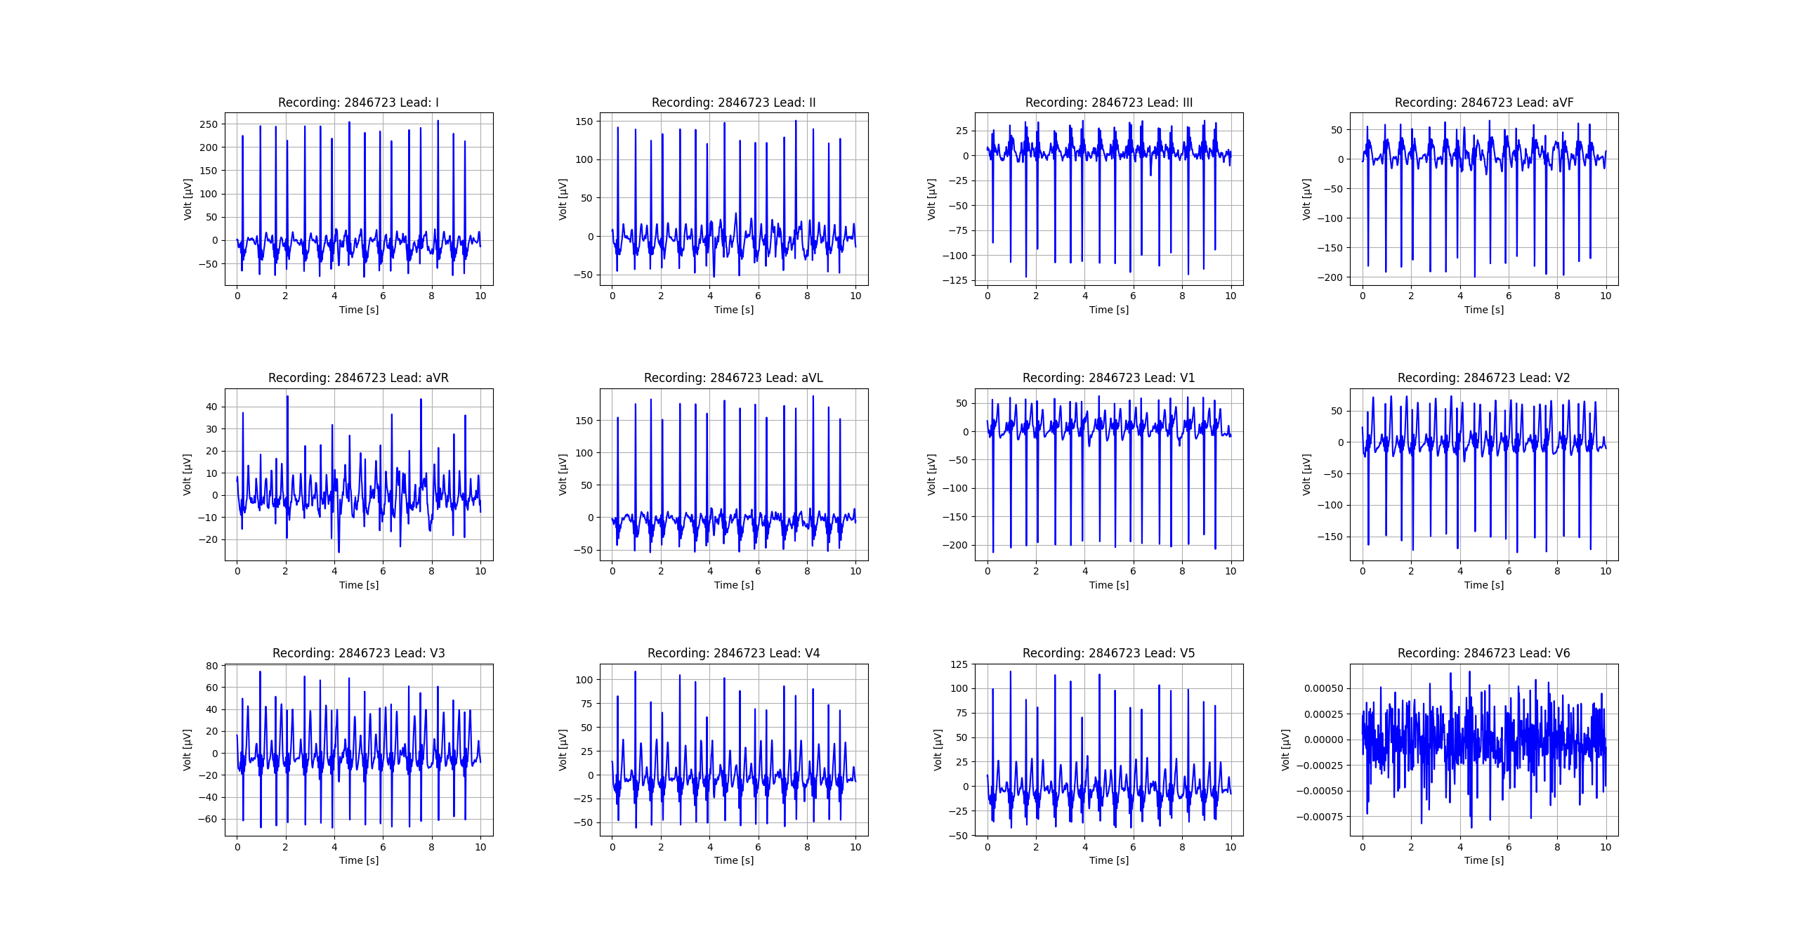
Figure_39

Slide 40

Figure_40

Slide 41
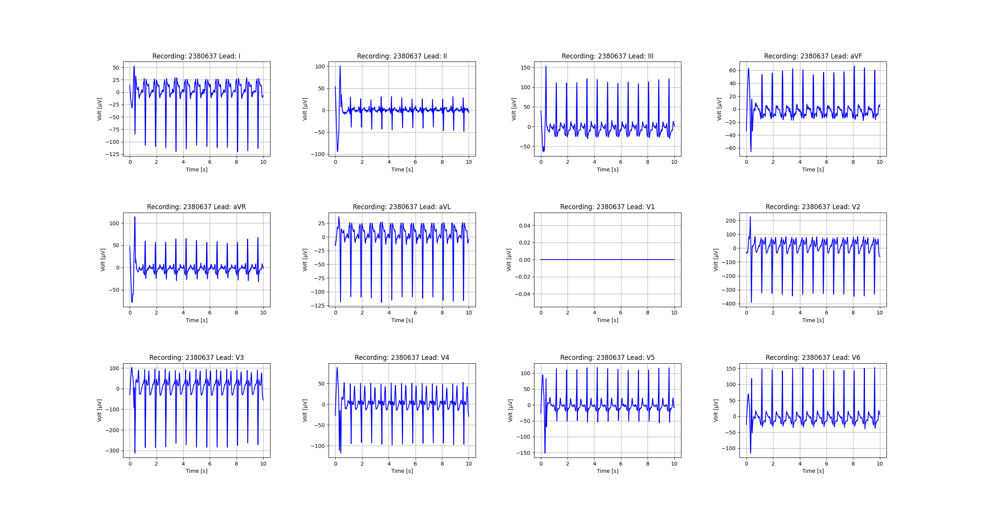
Figure_41

Slide 42
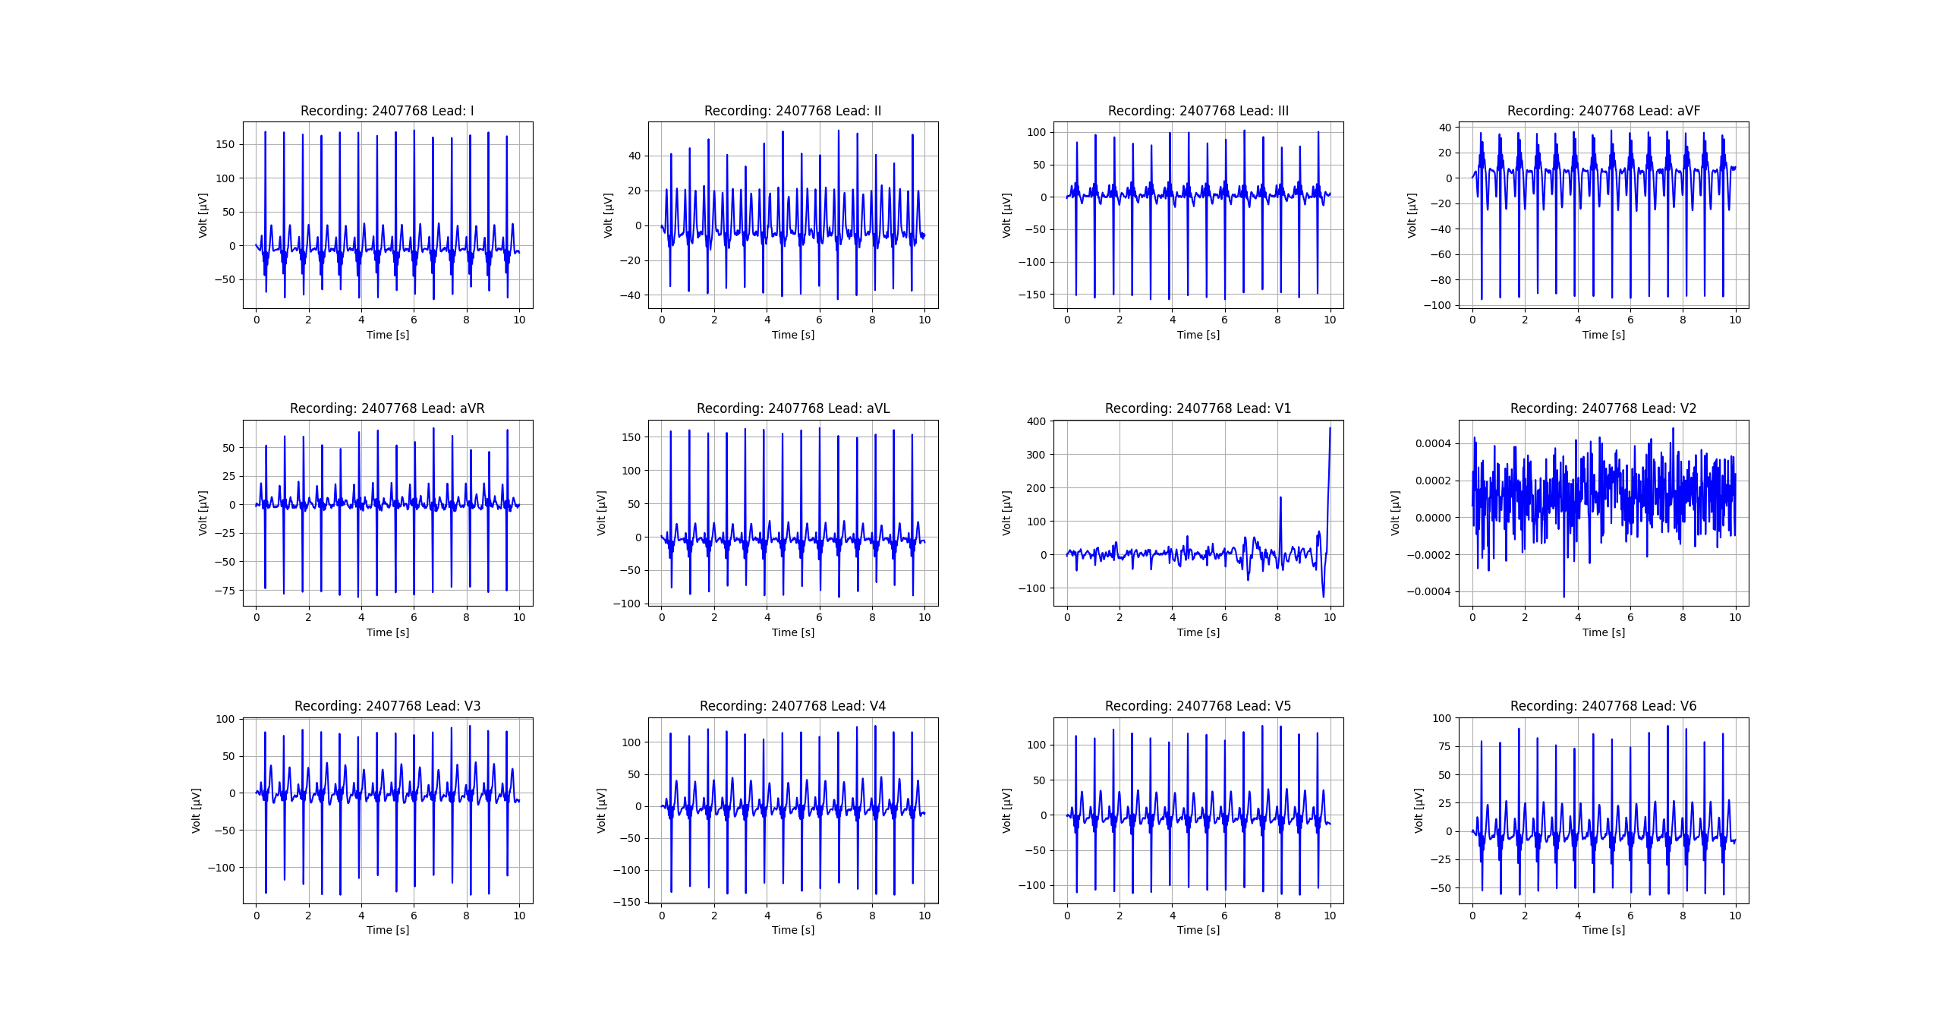
Figure_42

Slide 43

Figure_43

Slide 44

Figure_44

Slide 45

Figure_45

Slide 46
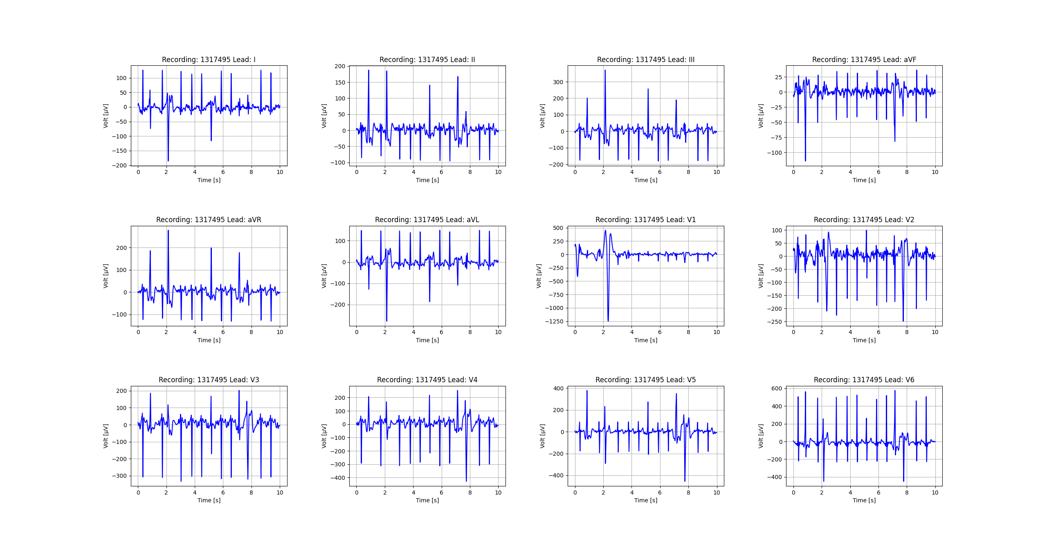
Figure_46

Slide 47

Figure_47

Slide 48
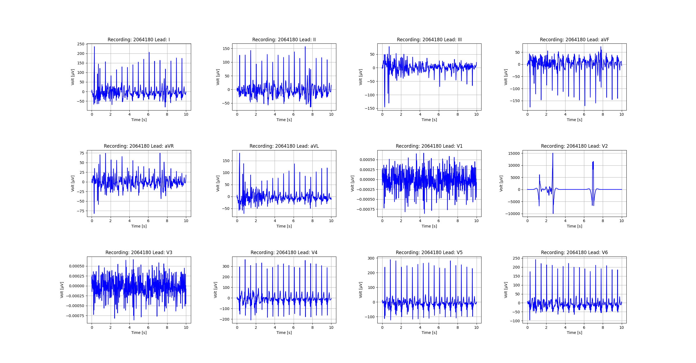
Figure_48

Slide 49
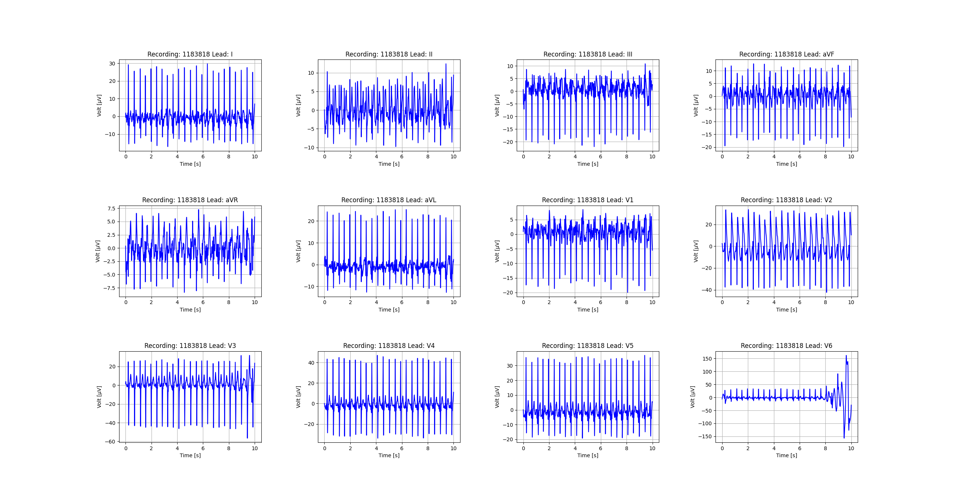
Figure_49

Slide 50

Figure_50

